Slide 1
MALLA REDDY UNIVERSITY III Year B. Tech – I Semester L/T/P/C 3/0/0/3 (MR20-1BM0163) HUMAN RESOURCE MANAGEMENT (HRM)

Slide 2
Course objectives:
•To educate on the concepts, significance and role of Human Resource Management in an Organization.
To impart knowledge on the aspects of Talent Management, Manpower Planning, Recruitment and selection.
To educate on the processes of Training & Development and Performance Management & Appraisals.
To highlight the significance of effective Compensation, Rewards and Employee Welfare Practices in Organizations along with the relevant Acts.

Slide 3
Unit-I
Unit – I: Introduction of: HRM
Introduction to HRM-Definition, importance, HR functions. Line Managers, New Approaches to Organizing HR, HR Score Card. Human Resource Information System (HRIS), e-HRM.

Slide 4
Unit – II: Recruitment and Selection:
Job Analysis, Methods for Collecting Job Analysis Information, Job Descriptions and Specifications, Job Satisfaction, Job Enlargement, Job Enrichment and Job Rotation, HR Planning, Recruitment, e-Recruitment & Selection Process, Sources of Recruitment, Employee Testing and Selection, Basic Types of Interviews, Errors in Interviews.

Slide 5
Unit – III: Training and Development:
Importance of Training and Development, Training Process, Analyzing Training Needs & Designing the Program, Implementation of training programs, Training Methods, Management Development Process, Evaluation of Training and Development programs.

Slide 6
Unit – IV: Performance Management
Concept of Performance Management and Appraisal
The Performance Appraisal Process
Techniques for Performance Appraisal
Career Management.

Slide 7
Unit – V Compensation and Employee Welfare
Basic Factors in Determining Pay Rates,
Job Evaluation Methods, Compensation and Reward Structure, Pricing Managerial and Professional Jobs, Performance based Pay Benefits
Insurance, Retirement Benefits, Employee Welfare Facilities.
Salient Features of Workmen Compensation Act & Minimum Wages Act.

Slide 8
Course Outcomes:
Understand the concepts, role and functions of HRM
Learn the methods of recruitment and selection.
Gain an understanding of various concepts and practices of Employee Training & Development and Performance Management & Appraisals.
•Learn the principles and practices of Employee Compensation and Rewards, with the help of Job Evaluation & Broad-banding etc and the salient features of Workmen Compensation Act and Minimum Wages Act.

Slide 9
TEXT BOOKS/REFERENCES:
1.P. Subba Rao, Essentials of Human Resource Management, Himalaya Publishing, 6e, 2021.
2.Biswajeet Pattanayak, Human Resource Management, 5e, 2018.
1.Gary Dessler, Biju Varkkey, Human Resource Management, Pearson, 4e, 2017.
2.Robert L. Mathis, John H. Jackson, Manas Ranjan Tripathy, Human Resource Management, Cengage Learning 2016.
3.Biswajeet Pattanayak, Human Resource Management, 5e, 2018.
4.K. Aswathappa, Human Resource Management: Text and Cases, TMH,8e, 2017.
5.Sharon Pande and Swapnalekha Basak, Human Resource Management, Text and Cases,

Slide 10
Happy Learning

Slide 11
Unit – I: Introduction of HRM:

Slide 12


Slide 13
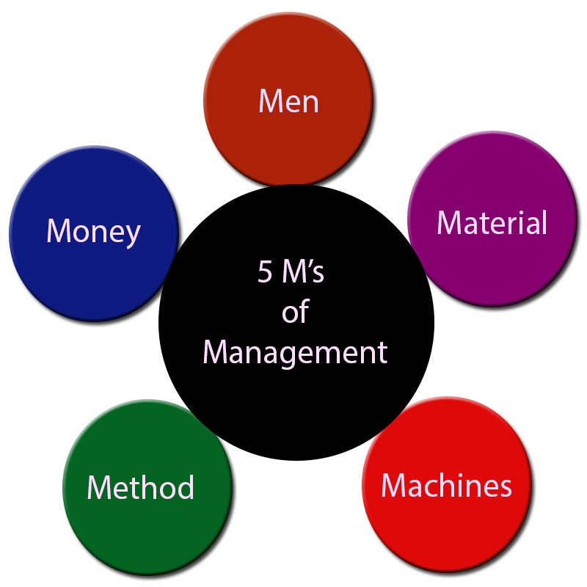
Business management

Slide 14
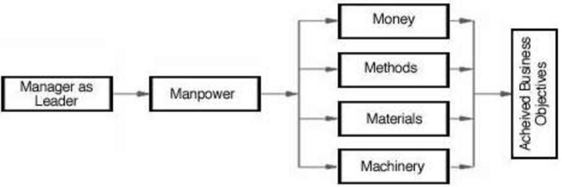

Slide 15
The idea that organizations “compete through people” highlights the fact that achieving success increasingly depends on an organization’s ability to manage talent, or human capital.
The term human capital describes the economic value of employees’ knowledge, skills, and capabilities.
“Successful companies of the twenty-first century will be those who do the best jobs of capturing, storing, and leveraging what their employees know.” (Lew Platt, Hewlett-Packard)

Slide 16
Human Resource management
HRM can be defined as
The art of procuring, developing, coordinating and maintaining competent workforce to achieve organizational goals efficiently.

Slide 17
HRM Defination
According to the flippo, HRM is the planning, organizing, directing and controlling of the procurement, development, compensation, integration, maintenance and separation of human resource so that the objectives are accomplished

Slide 18
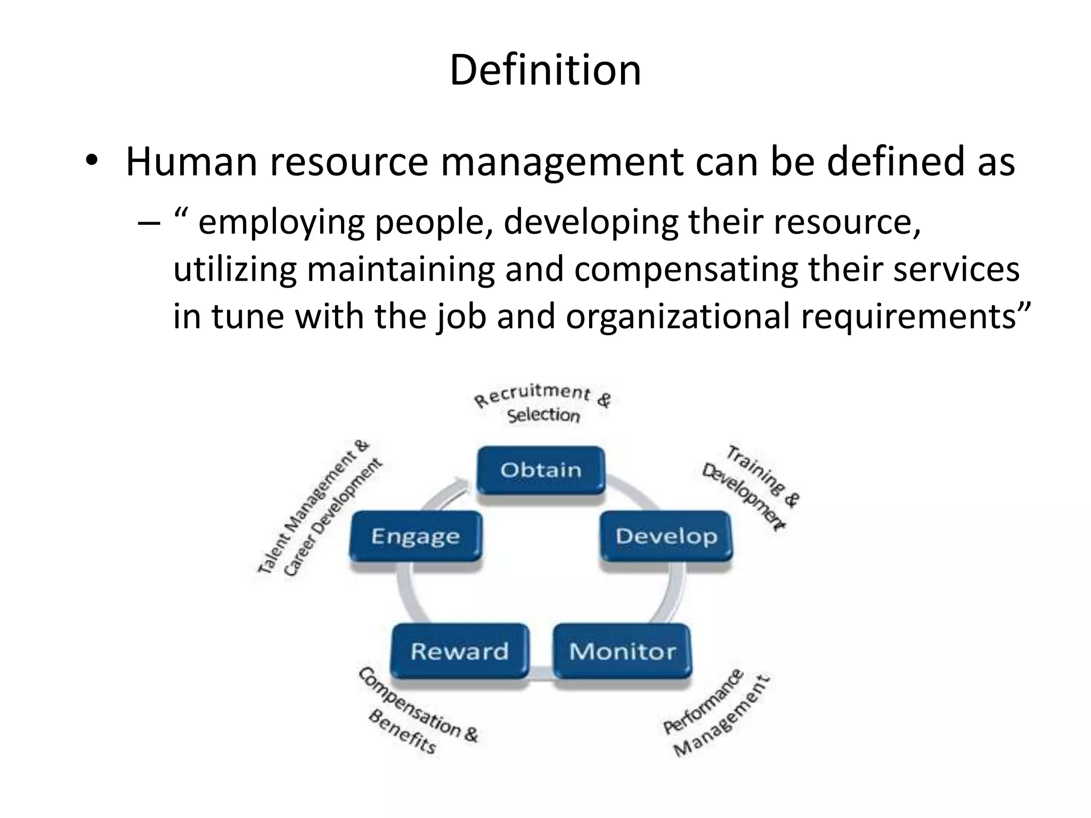

Slide 19
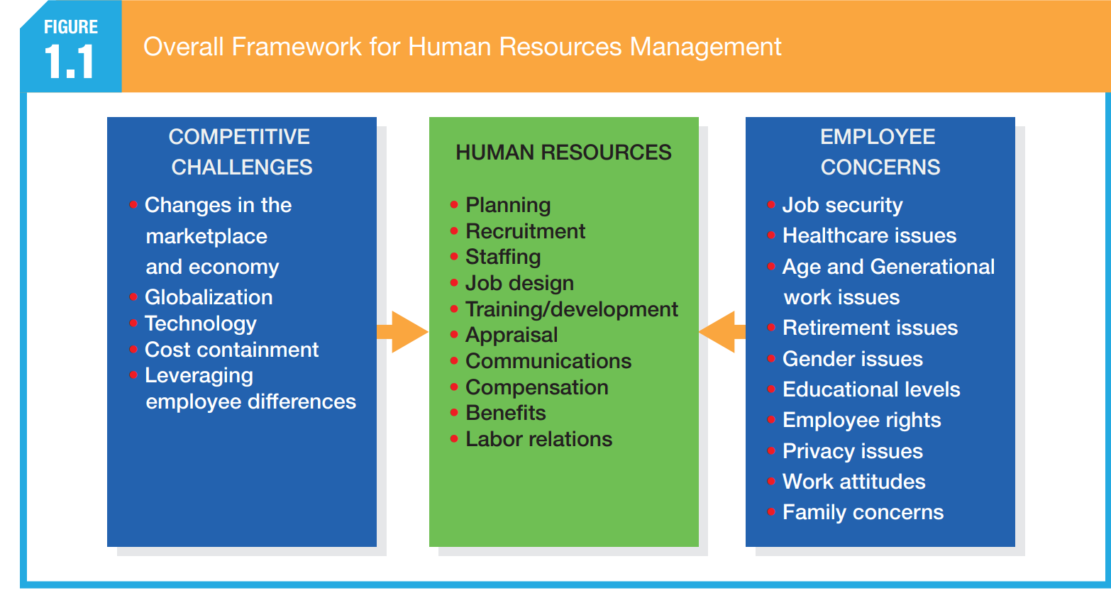

Slide 20
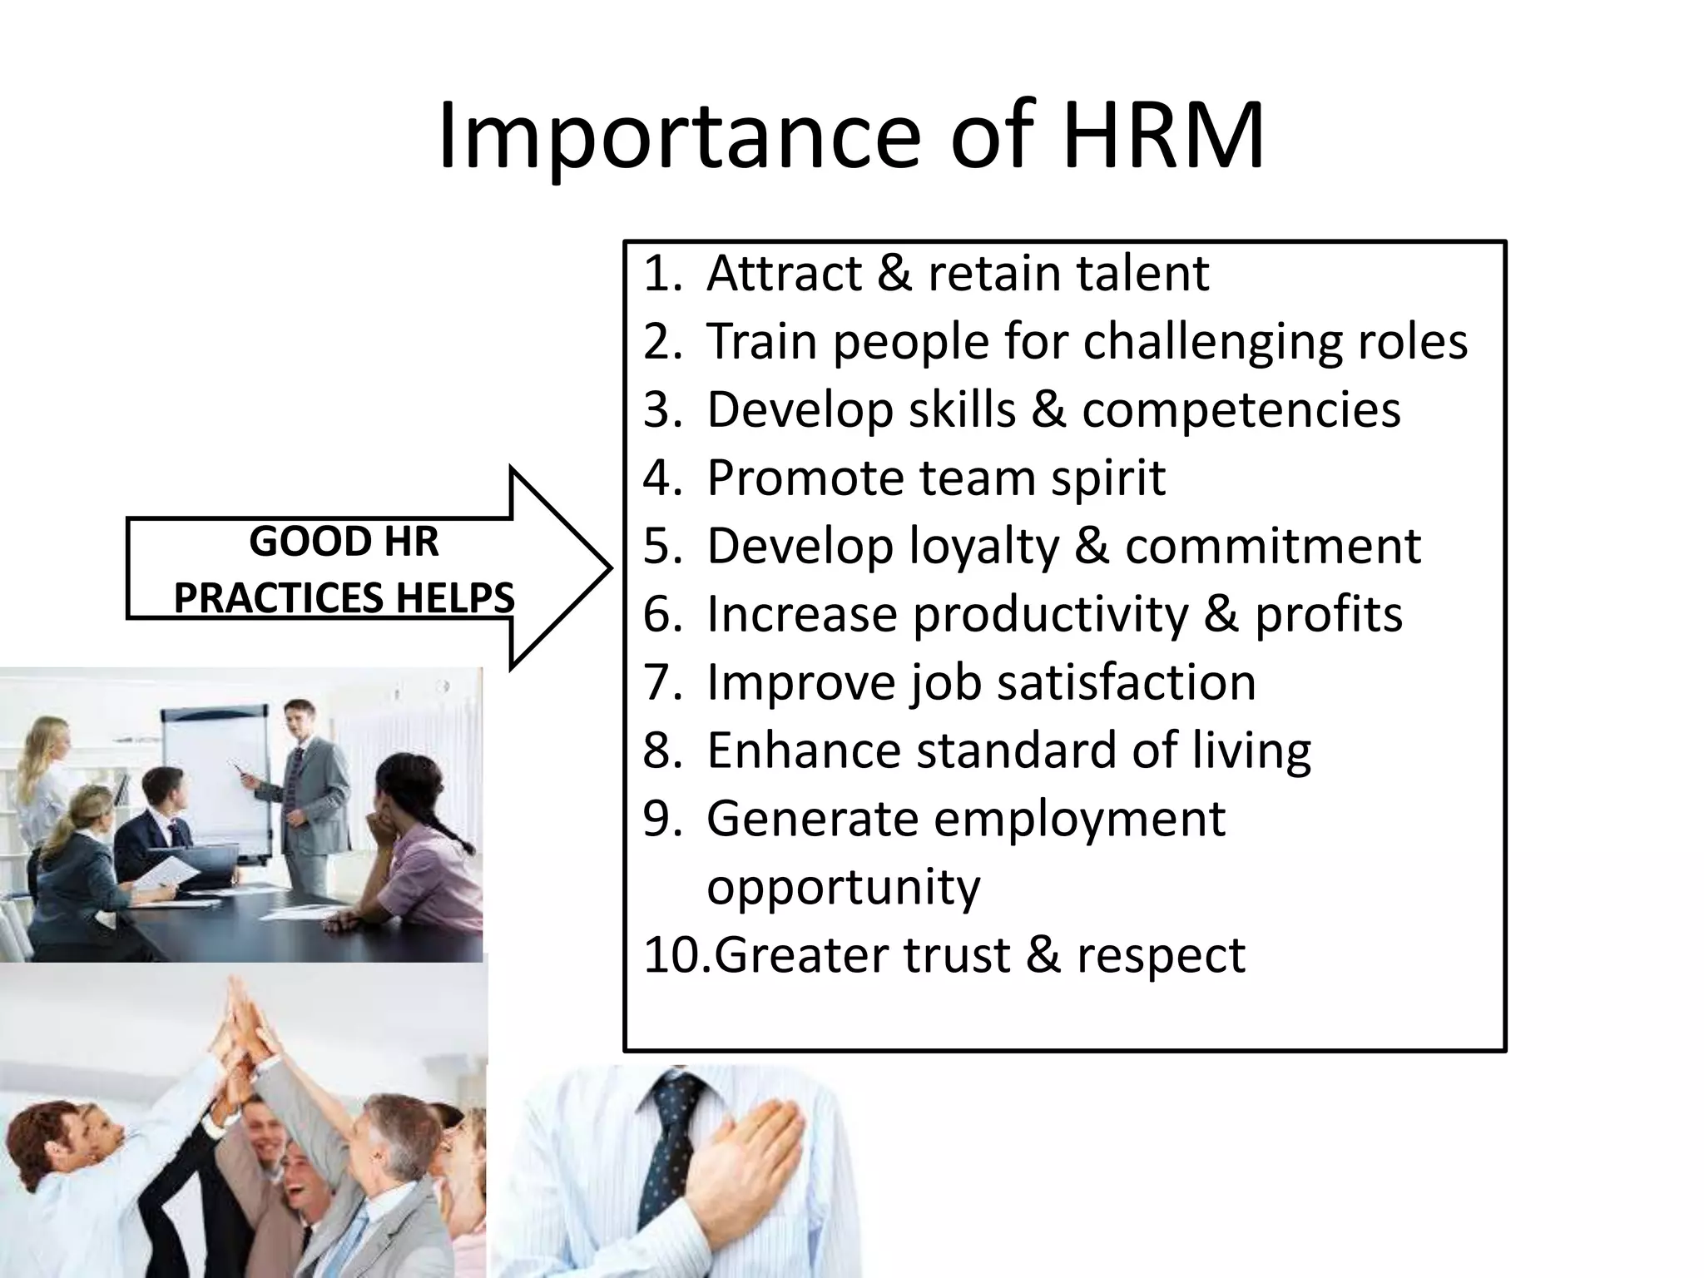

Slide 21
Nature of HRM
People-Centric Approach
Universal
Action oriented
Continious functions
Interdiciplinary
Strategic Alignment
Comprehensive Functionality

Slide 22
Nature of HRM
Development and Growth
Employee Engagement
Adaptability and Change Management:
Legal and Ethical Compliance
Metrics and Analysis:

Slide 23
The nature of Human Resource Management (HRM)
People-Centric Approach: HRM focuses on managing people within the organization. It deals with employees as individuals with unique skills, motivations, and aspirations rather than just resources or assets.
Strategic Alignment: HRM aligns its practices and policies with the strategic goals and objectives of the organization. It plays a pivotal role in ensuring that the workforce capabilities and organizational needs are in sync to achieve long-term success.
Comprehensive Functionality: HRM covers a wide range of functions including recruitment and selection, training and development, performance management, compensation and benefits, employee relations, and compliance with employment laws and regulations.
Development and Growth: HRM is involved in nurturing talent and developing the skills and capabilities of employees. This includes providing training opportunities, career development programs, and succession planning to ensure a continuous pipeline of skilled workers.

Slide 24
Employee Engagement: HRM strives to create a positive work environment where employees are motivated, engaged, and productive. It focuses on fostering a culture of trust, open communication, and collaboration within the organization.
Adaptability and Change Management: HRM plays a crucial role in managing organizational change and adaptation. It helps employees navigate transitions, implement new initiatives, and cultivate a culture that embraces innovation and continuous improvement.
Legal and Ethical Compliance: HRM ensures that all employment practices and policies adhere to legal requirements and ethical standards. This includes ensuring fair treatment, equal opportunity, diversity and inclusion, and compliance with labor laws and regulations.
Metrics and Analysis: HRM utilizes data and metrics to inform decision-making and measure the effectiveness of HR practices. This includes tracking employee performance, turnover rates, engagement levels, and other key indicators to optimize HR strategies.

Slide 25
(HRM) key functions
Human Resource Management (HRM) involves several fundamental functions that are crucial for managing employees effectively within an organization. Here are the basic functions of HRM along with an image to illustrate them:
HR Planning and Strategy
Recruitment and Selection:
Training and Development:
Performance Management:
Compensation and Benefits
Employee Relations:

Slide 26
HR Planning and Strategy: HRM aligns human resource policies and practices with the organization’s strategic goals. This includes workforce planning, succession planning, and implementing HR strategies to support business objectives.
Recruitment and Selection: This involves attracting and hiring qualified candidates for various roles within the organization. HR professionals manage job postings, screening resumes, conducting interviews, and making hiring decisions.
Training and Development: HRM ensures that employees receive the necessary training to perform their jobs effectively. This includes orientation for new hires, skills development programs, and continuous learning opportunities.

Slide 27
Performance Management: HRM monitors and evaluates employee performance through regular assessments and feedback sessions. This function includes setting performance goals, conducting appraisals, and providing recognition or corrective actions as needed.
Compensation and Benefits: HRM administers employee compensation and benefits programs. This includes determining salaries, bonuses, incentives, and managing benefits such as health insurance, retirement plans, and other perks.
Employee Relations: HRM fosters positive relationships between employees and the organization. This involves handling grievances, mediating conflicts, and promoting a supportive work environment.

Slide 28
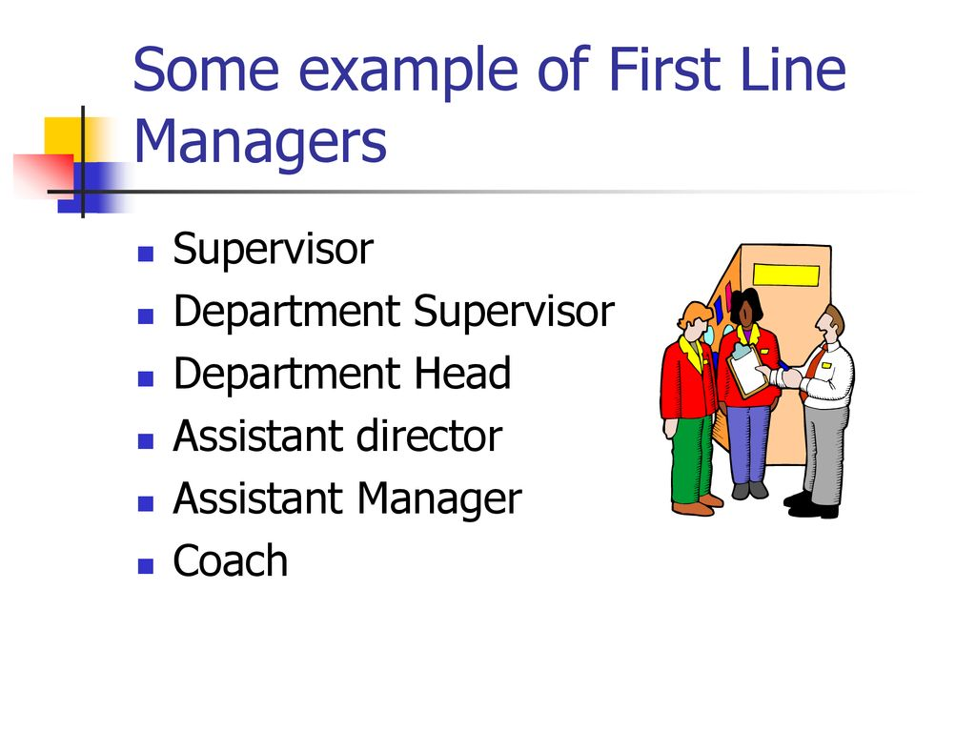
Line Manager
A line manager, often referred to simply as a “manager,” is an individual who has direct responsibility over employees and their work in an organisation.

Slide 29
Line management
Line management refers to the management of employees who are directly involved in the production or delivery of products, goods and/or services. As the interface between an organisation and its front-line workforce, line management represents the lowest level of management within an organisational hierarchy.

Slide 30
Line Managers

Slide 31
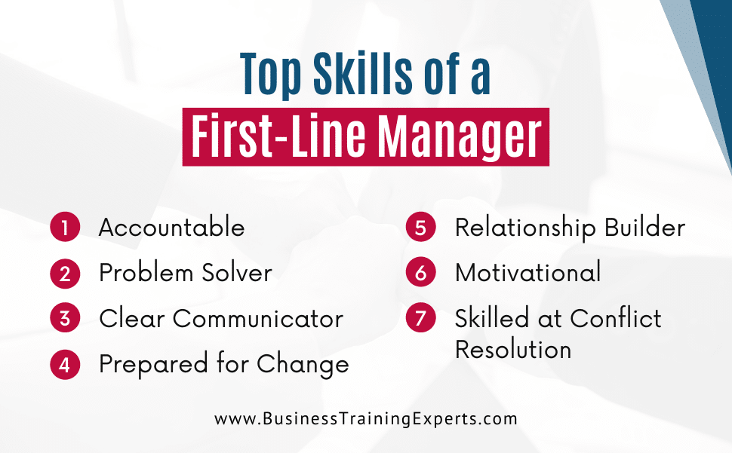
line manager skills

Slide 33
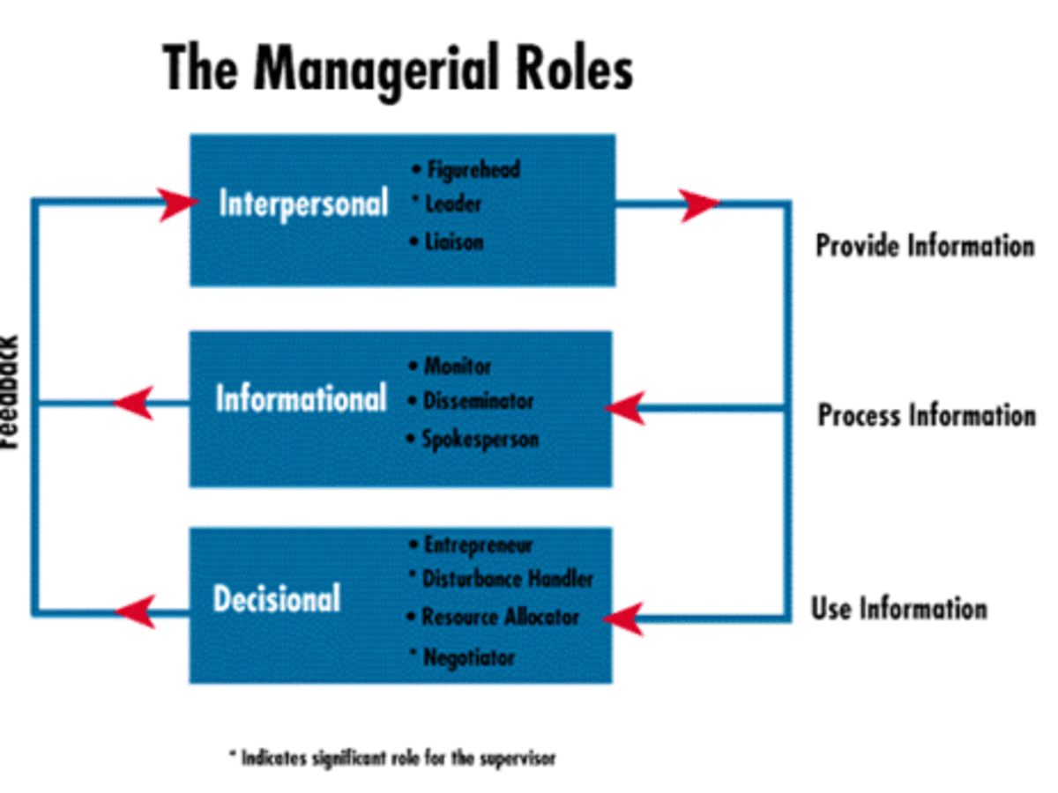
Roles of line manager

Slide 34
New Approaches to Organizing HR
Organizing HR in a modern, effective way is crucial for aligning people management with overall business strategy. Here are some new approaches and trends in HR organization:
Strategic Partnership Model
Employee Experience Focus
Decentralized HR Models
Technology-Driven HR
Agile HR
Focus on Well-Being
Diversity, Equity, and Inclusion (DEI)
8. Learning and Development as a Core Function
Talent Management and Succession Planning
10. Collaborative HR
Data-Driven Decision Making

Slide 35
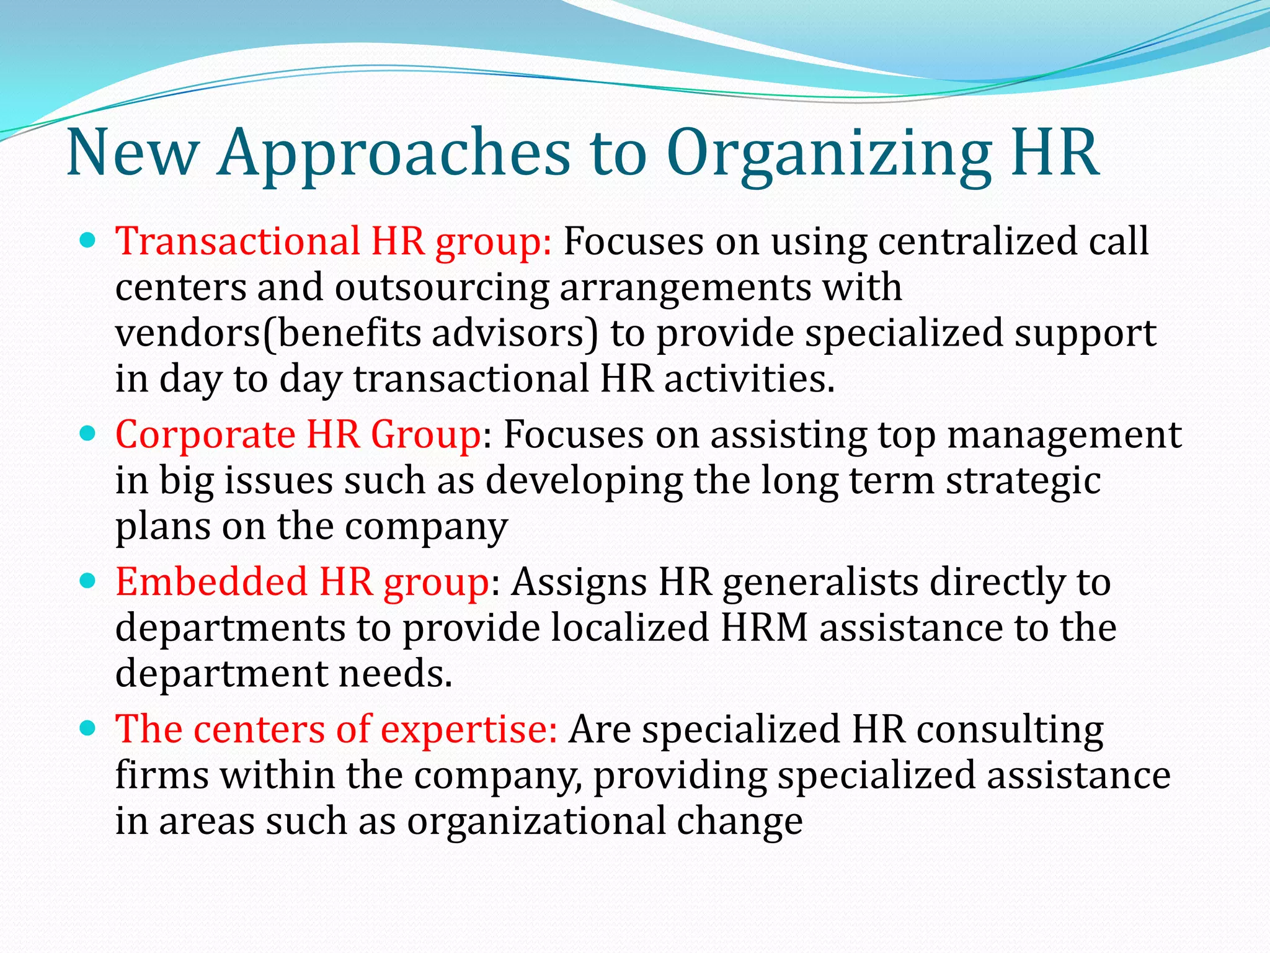

Slide 36
HR Score Card
The HR scorecard, or Human Resource Scorecard, is a strategic HR measurement system. It assesses, manages, and improves the HR department's role. It measures leading HR indicators that forecast business growth, including human capital ROI, employee turnover, recruitment effectiveness, and more.
The HR scorecard, first published about by Becker, Huselid & Ulrich in their 2001 book that bore the same title.

Slide 37
HR Score Card
This tool tracks HR function performance and aligns with strategic plans. It enables targeted investments in HR to support business objectives. The HR scorecard ensures alignment with overall business goals and helps identify areas needing attention. It aids in making informed decisions about resource allocation.

Slide 38
How Can An HR Scorecard Help Improve HR Performance
Aligning HR goals with business goals: The HR scorecard ensures that HR goals are aligned with the overall goals of the business, leading to more effective use of resources and better business outcomes.
Identifying areas for improvement: The HR scorecard highlights areas where the HR department is not performing well, allowing for targeted improvements and interventions.
Prioritizing HR initiatives: By measuring various aspects of HR performance, the HR scorecard helps organizations prioritize which HR initiatives should be focused on, ensuring that resources are allocated effectively.
Evaluating HR effectiveness: The HR scorecard provides a clear understanding of the strengths and weaknesses of the HR department, enabling organizations to make informed decisions about resource allocation and support.
Providing feedback and development opportunities: The HR scorecard can be used to identify employees who need additional support or development, allowing HR to address these issues proactively.

Slide 39
steps
1. Define Objectives and Goals/deliverables
Step: Identify the strategic objectives of your organization and determine how HR can support these objectives.
Example:
•Organization’s Objective: Increase revenue by 15% over the next year.
•HR Goal: Enhance talent acquisition and development to support revenue growth.
2. Identify Key HR Metrics/KPI’s
Step: Choose metrics that align with the identified HR goals and can effectively measure progress.
Example:
•Talent Acquisition Metrics: Time to Fill, Quality of Hire
•Employee Development Metrics: Training Participation Rate, Internal Promotion Rate
•Performance Management Metrics: Performance Appraisal Completion Rate, Performance Improvement Plan Success Rate
•Retention Metrics: Employee Turnover Rate, Retention Rate of Key Talent

Slide 40
3. Establish Targets
Step: Set specific, measurable targets for each metric to define what success looks like.
Example:
•Time to Fill: Target 30 days.
•Quality of Hire: Target 90% of new hires meeting or exceeding performance expectations.
•Training Participation Rate: Target 80%.
•Employee Turnover Rate: Target 10%.
•Retention Rate of Key Talent: Target 90%.
4. Collect Data
Step: Gather the necessary data to measure the selected metrics. Ensure data collection methods are accurate and consistent.
Example:
•Data Source: HR software, employee surveys, performance reviews, exit interviews.
•Collection Frequency: Monthly or quarterly reports.

Slide 41
5. Analyze and Interpret Data
Step: Review the data to assess performance against targets. Identify trends, strengths, and areas for improvement.
Example:
•Analysis: Current Time to Fill is 35 days (5 days above target). Quality of Hire is 85% (5% below target). Training Participation Rate is 70% (10% below target). Employee Turnover Rate is 12% (2% above target). Retention Rate of Key Talent is 85% (5% below target).
Develop Action Plans
Step: Based on the analysis, develop action plans to address any gaps or areas needing improvement.
Example:•Action Plan for Time to Fill: Review and streamline the recruitment process. Implement new applicant tracking system features.
•Action Plan for Quality of Hire: Improve interview and selection process. Increase focus on cultural fit.
•Action Plan for Training Participation Rate: Enhance employee awareness and accessibility of training programs. Provide incentives for participation.
•Action Plan for Employee Turnover Rate: Conduct exit interviews to identify common reasons for leaving. Improve employee engagement strategies.

Slide 42
Implement and Monitor
Step: Execute the action plans and continuously monitor progress. Regularly review and adjust strategies based on performance data.
Example:
•Implementation: Roll out new recruitment software and training incentives.
•Monitoring: Track progress monthly and review scorecard quarterly to ensure improvements are on track.

Slide 44
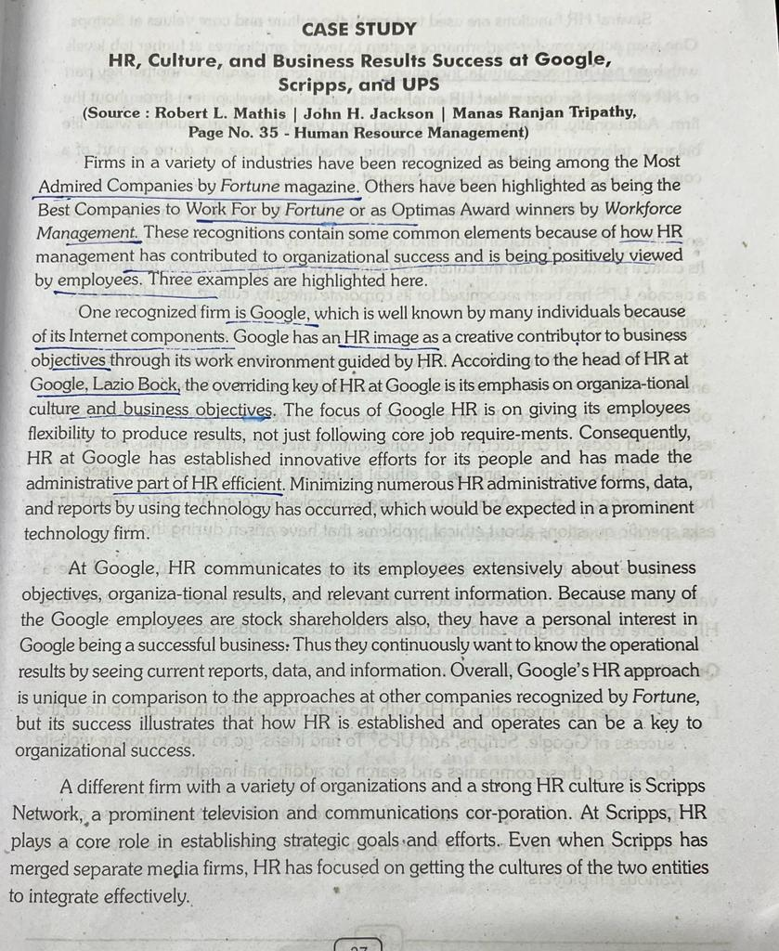

Slide 45
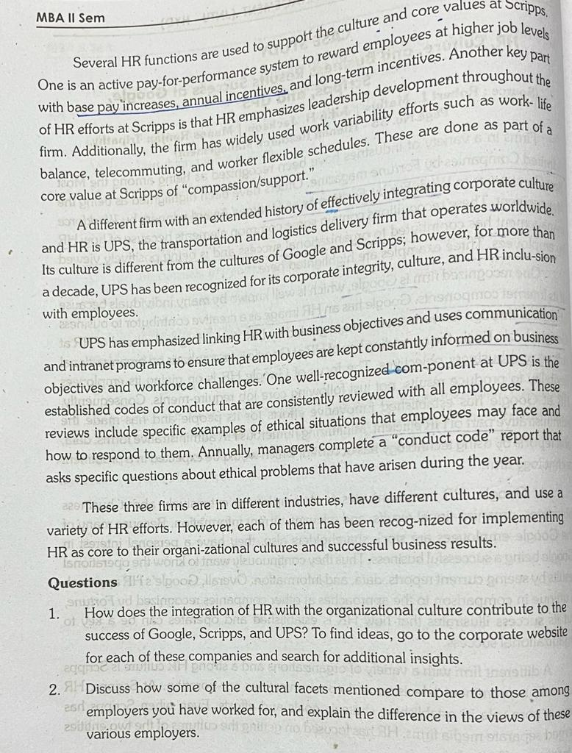

Slide 46
(HRIS) is defined as a software or online solution that is used for data entry, data tracking, and data management of all human resources operations of an organization.
HRIS stands for human resources information system, a software solution that helps companies manage and automate core HR processes and support benefits administration, time and attendance, payroll, and other workflows, as well as the storage of employee data, such as personal, demographic, and compensation information. HR information systems (HRIS) have increasingly transformed since it was first introduced at General Electric in the 1950s.
HRIS systems – or human resources information systems – were one of the first commercial software solutions to be developed in the 1980s.

Slide 47
According to Dr. Dave Ulrich, often regarded as the father of modern HR and a Professor at the University of Michigan.“An HRIS is a software or online solution for the data entry, tracking, and data information needs of a business's Human Resources, payroll, management, and accounting functions. It provides a means of acquiring, storing, analyzing, and distributing information to various stakeholders.”
1. Database management
The core offering of most human resource information system solutions is a ready-access database where all employee information can be stored and managed effectively.
2. Time and labor management
Monitoring the clocking hours of every single employee is a time-intensive task. With a majority of offices today allowing employees to either punch in biometrically or log on to input their own hours, this daily dose of data needs effective management.
Managers can now approve leave requests, and the data can be directly linked to payroll

Slide 48
3. Payroll functions
Payroll is one of the most important functions of HR. With a lean human resource information system allowing easy download or upload of employee hours and attendance data, the number crunch can be made a lot simpler, and deposits to employees made more seamless. This also leads to fewer errors by reducing human intervention.
4. Benefits management
Benefits management does not pertain only to medical benefits and retirement investments, but all queries, feedback, data, and communication related to benefits.
5. Employee interface
Most human resource information system software allows limited user access to employees, but even that moderate level of employee self-service is a step forward in creating a culture where employees have more operational freedom.

Slide 49
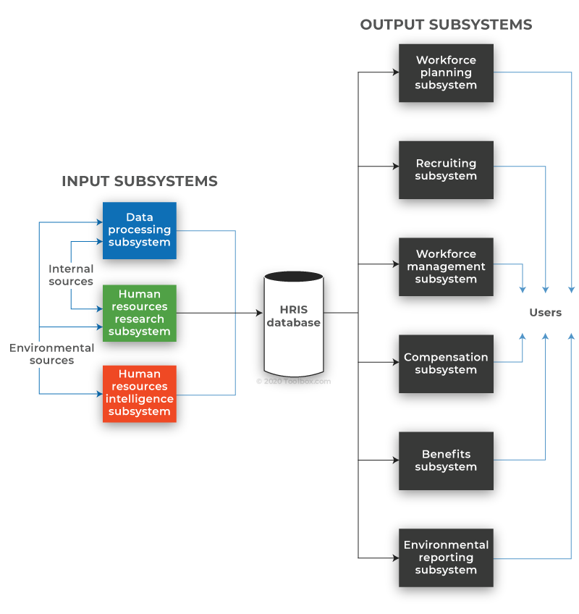

Slide 50
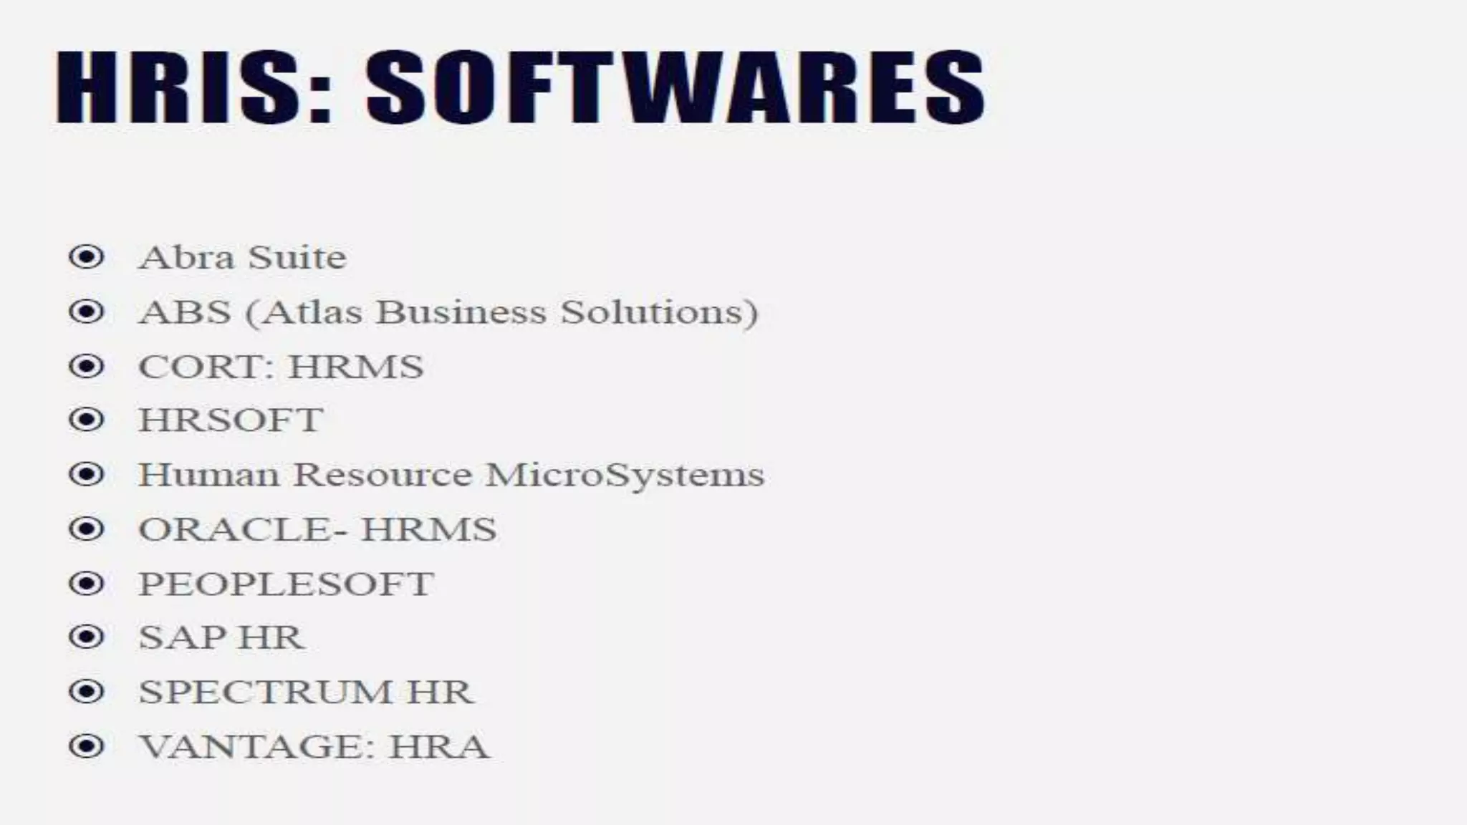

Slide 51
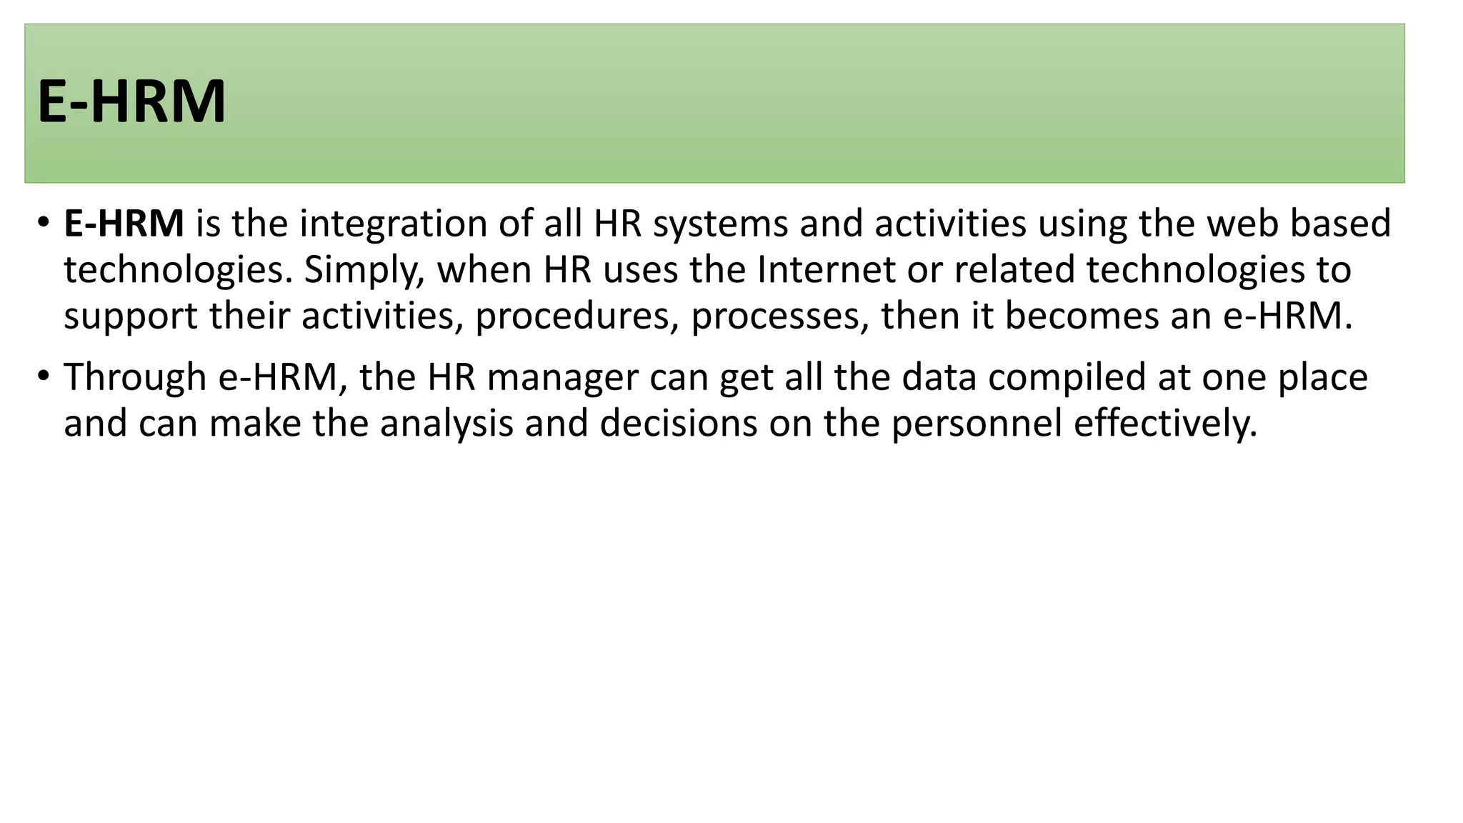
E-HRM/ Electronic HRM

Slide 52
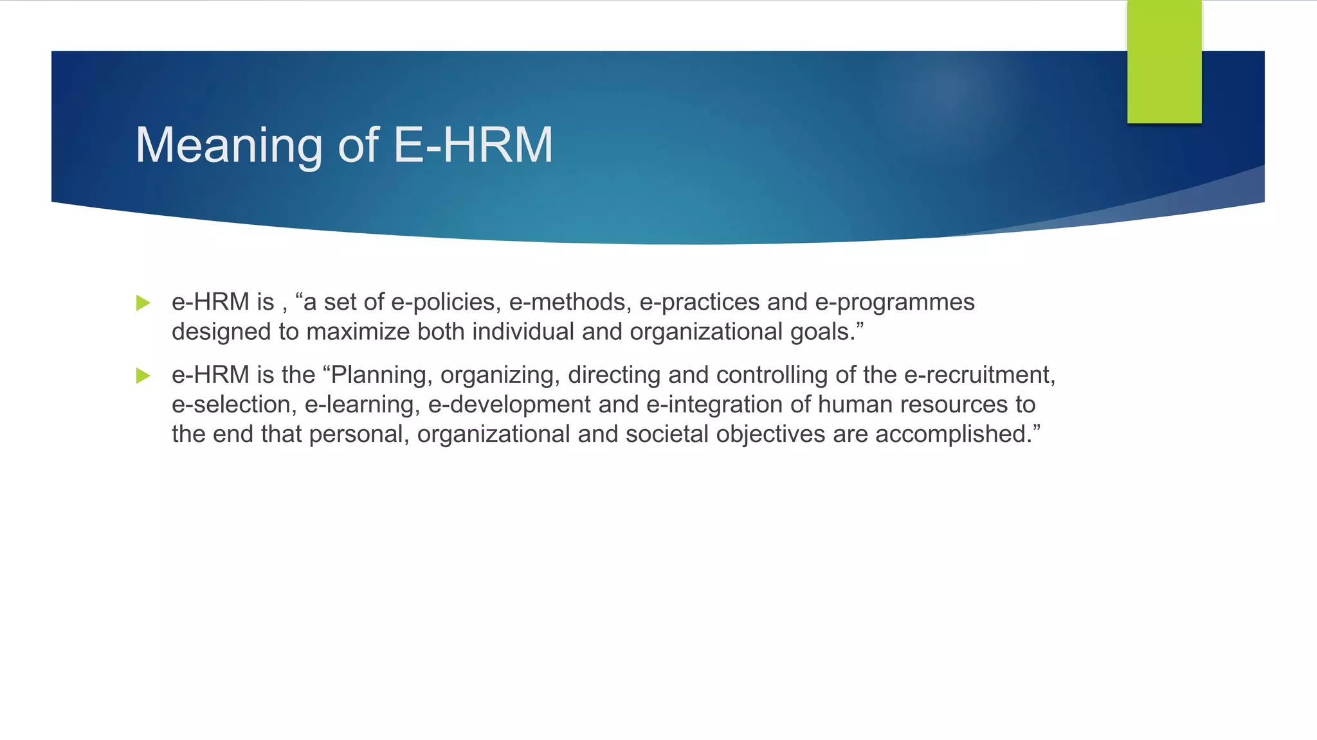
E-HRM/ Electronic HRM Human Resource Management (HRM) departments using information and communication technologies (ICTs) are becoming an increasingly important phenomenon called e-HRM. The integration of IT applications with Human Resource (HR) function An e-HRM system is also defined as “a way of implementing HR strategies, policies and practices in organisations through conscious and directed support of and/ or with the full use of web-technology-based channels

Slide 53
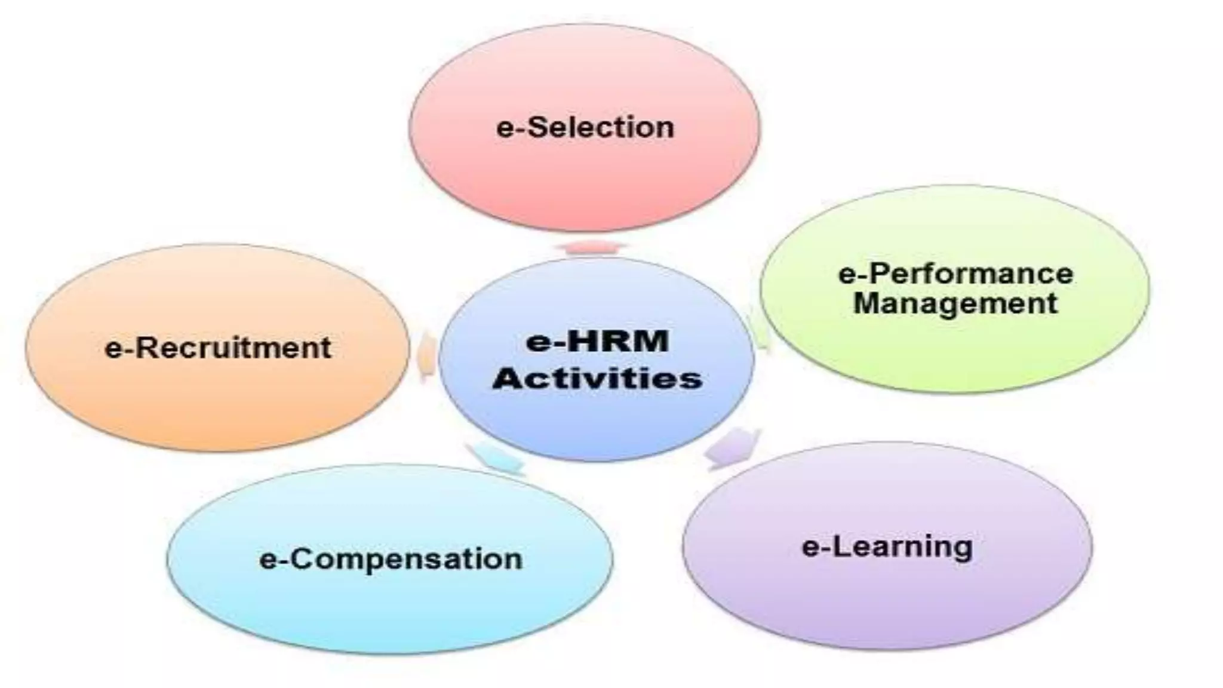

Slide 54
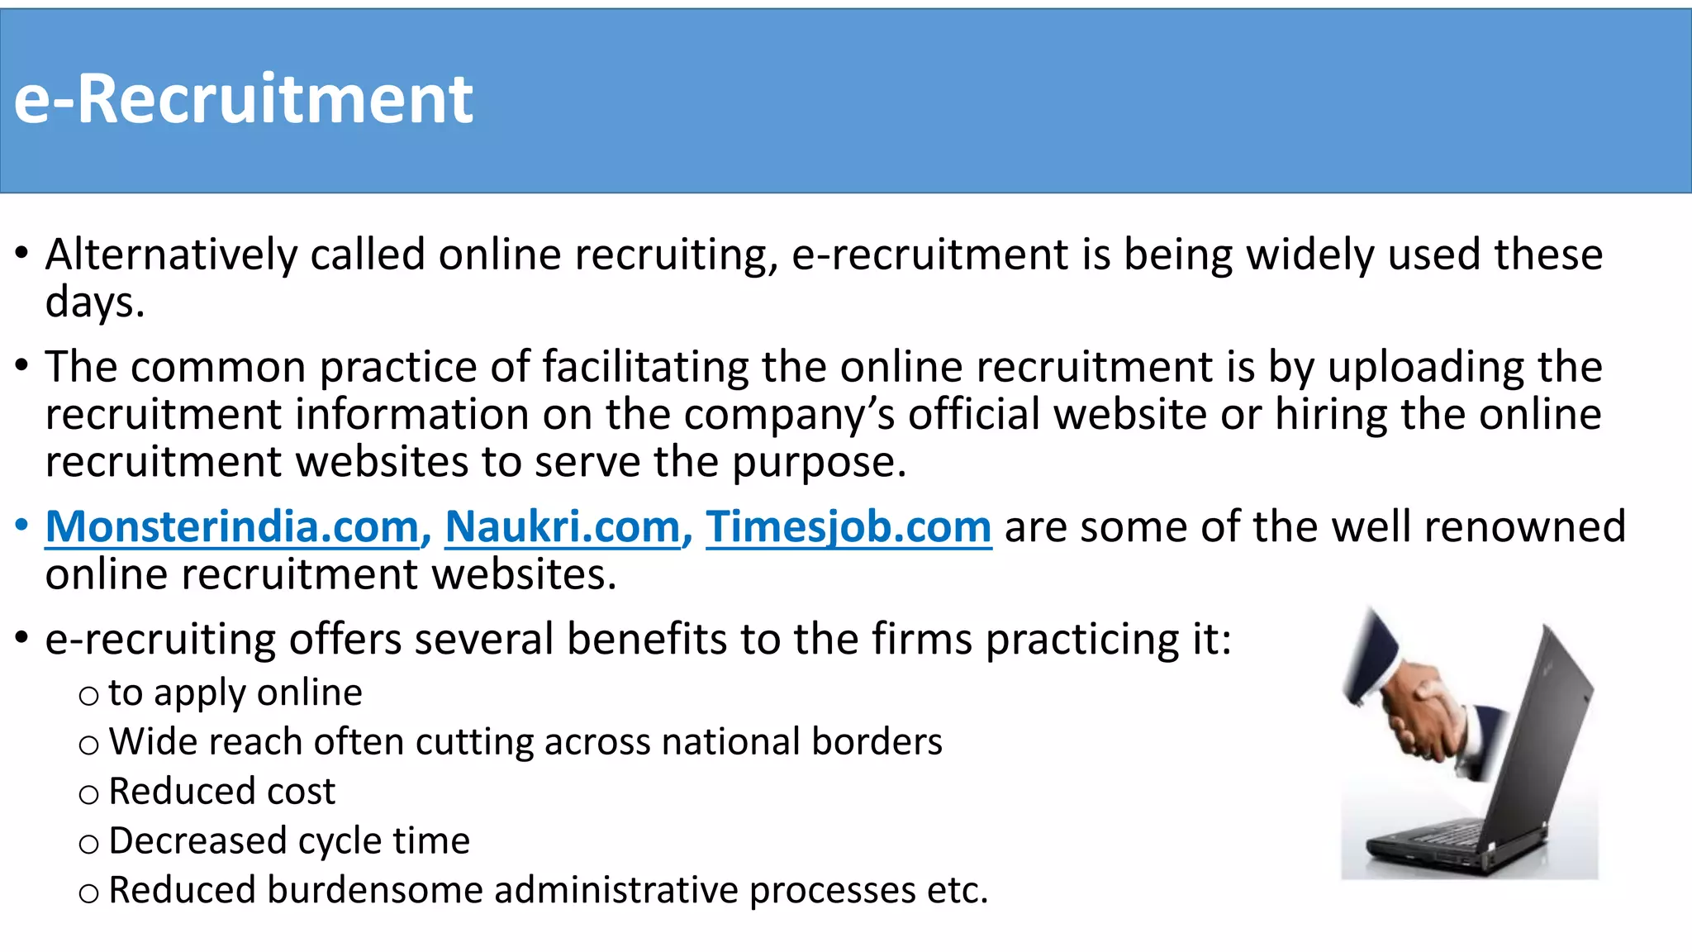

Slide 55
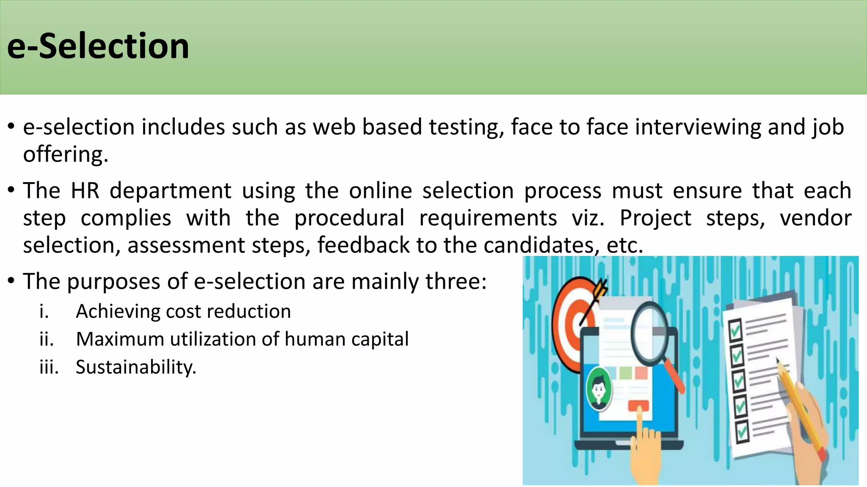

Slide 56
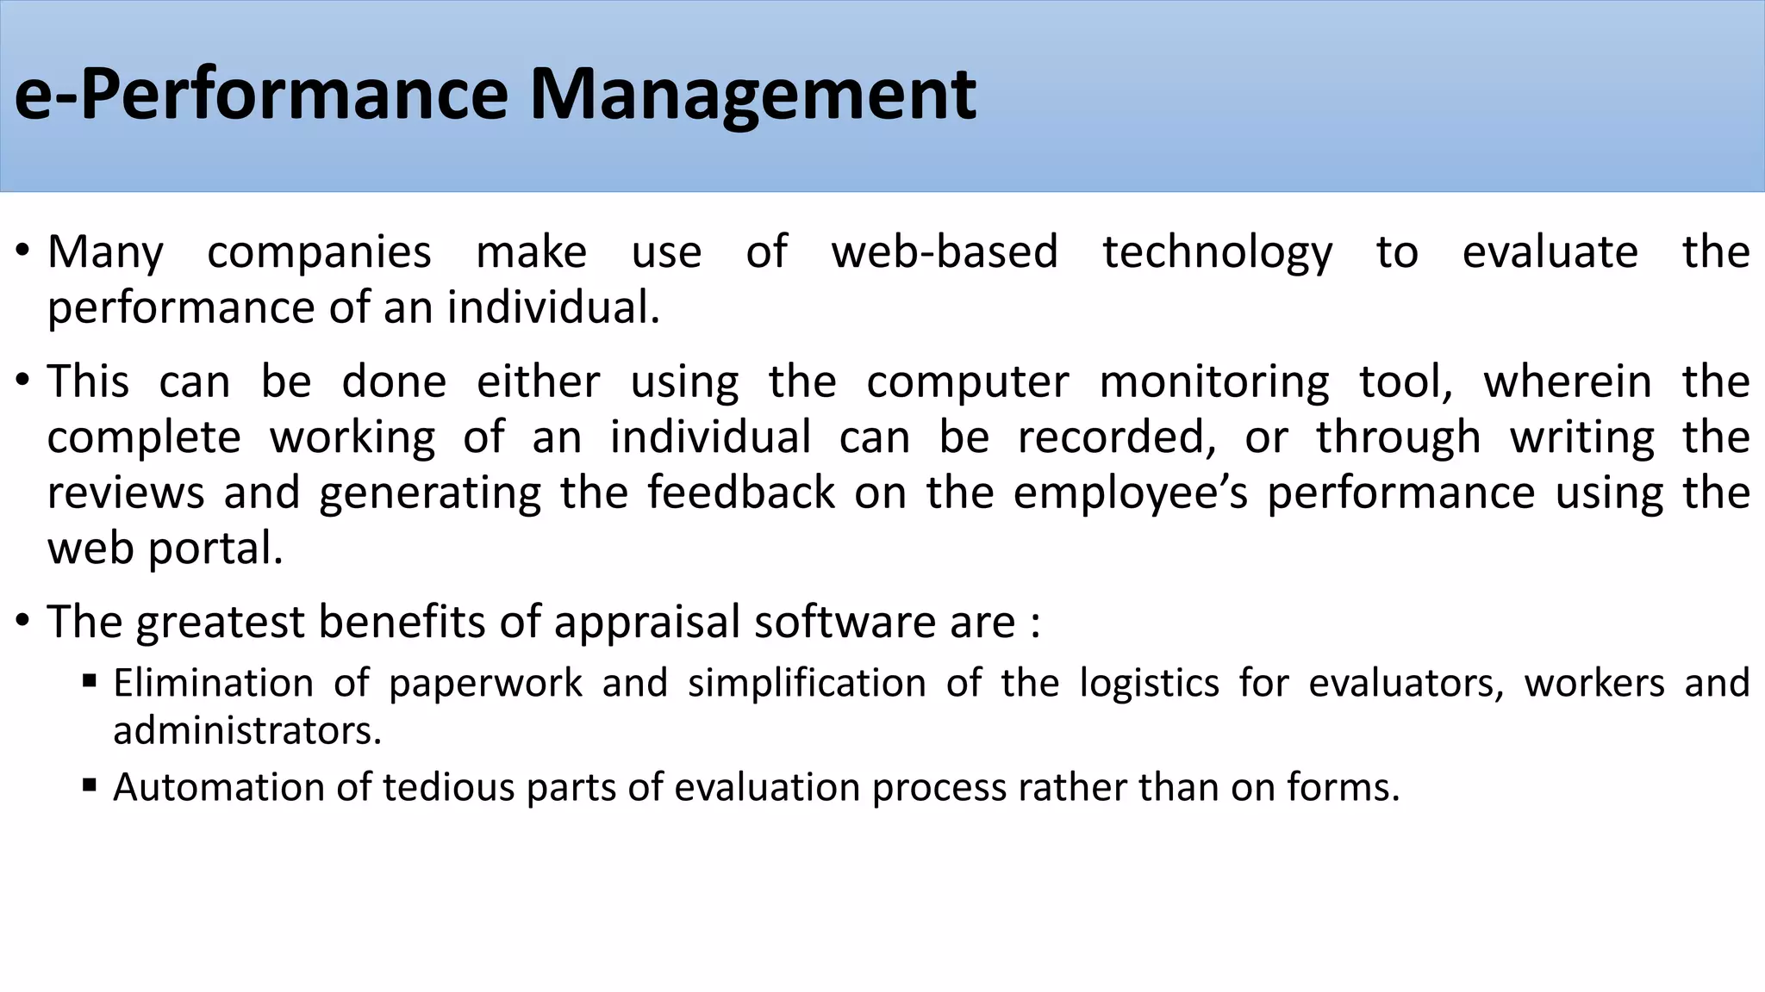

Slide 57
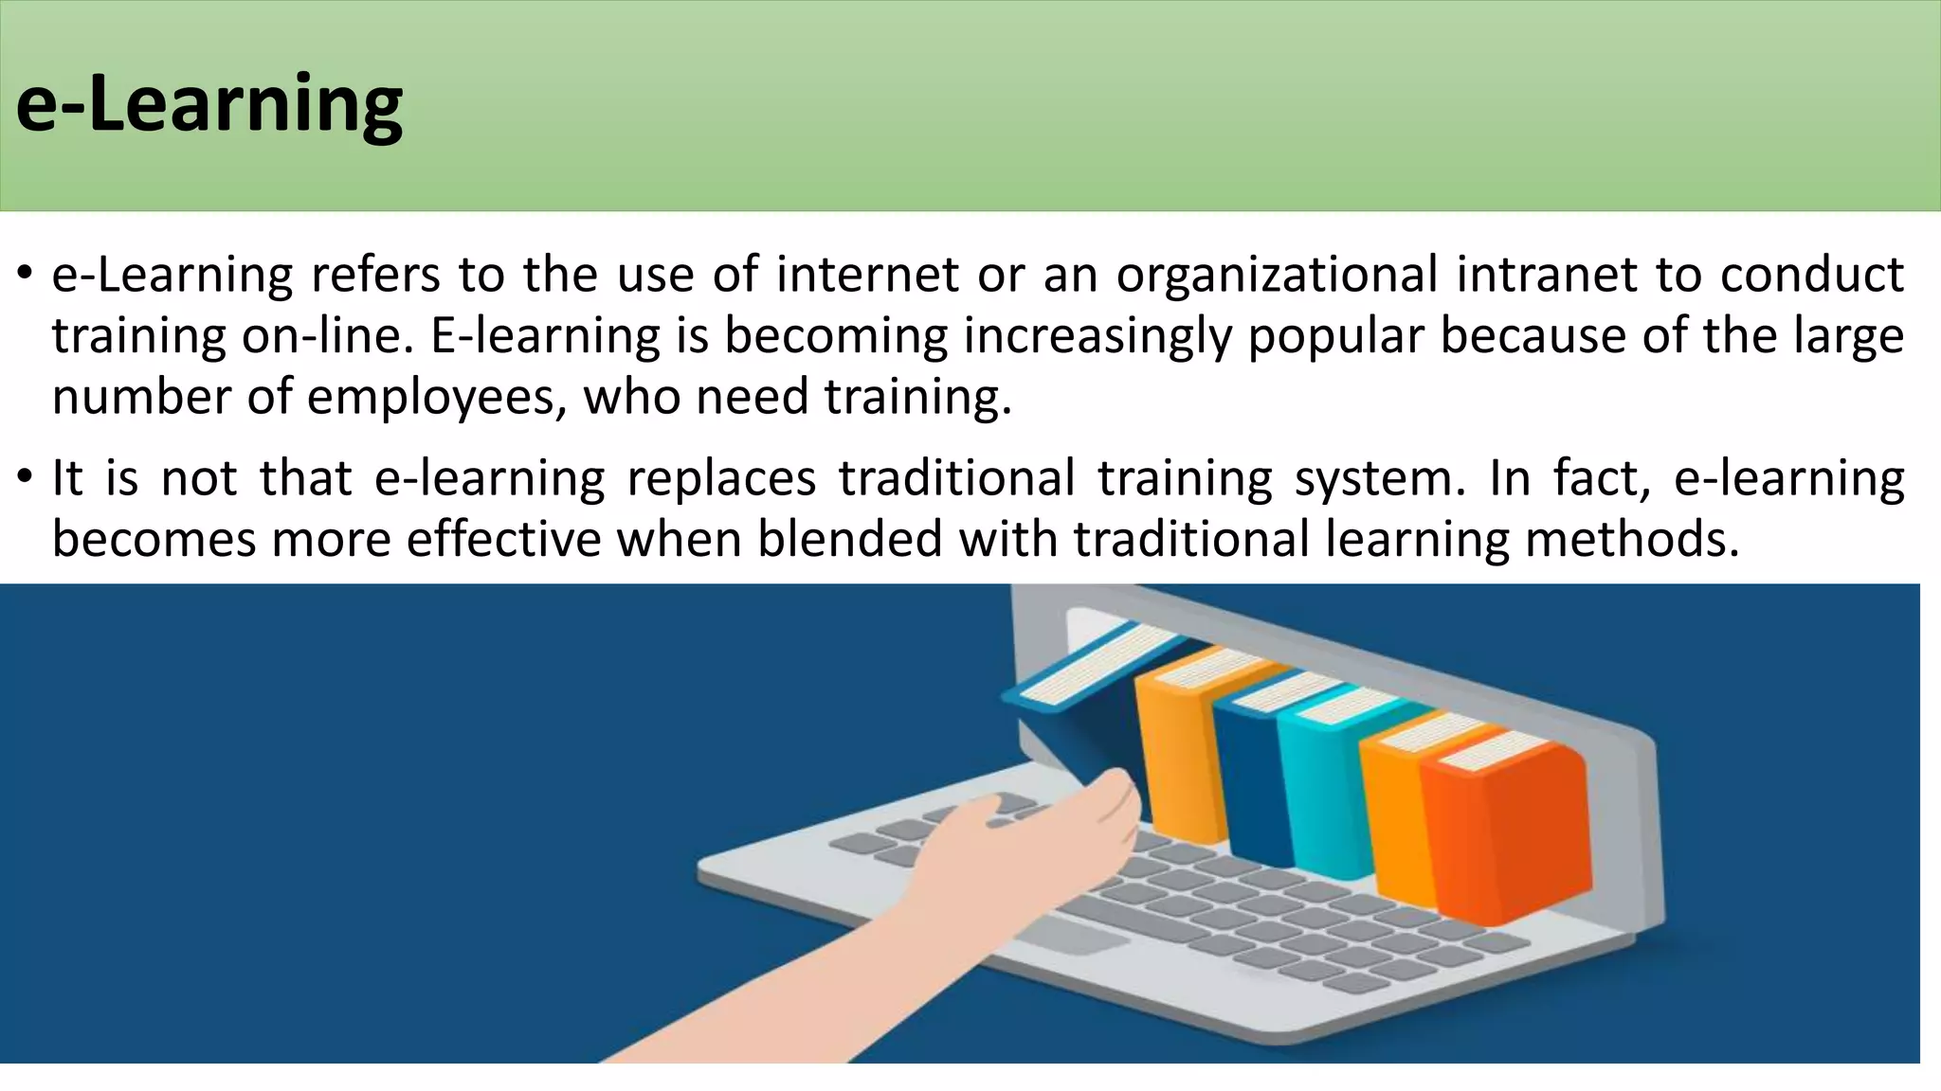

Slide 58
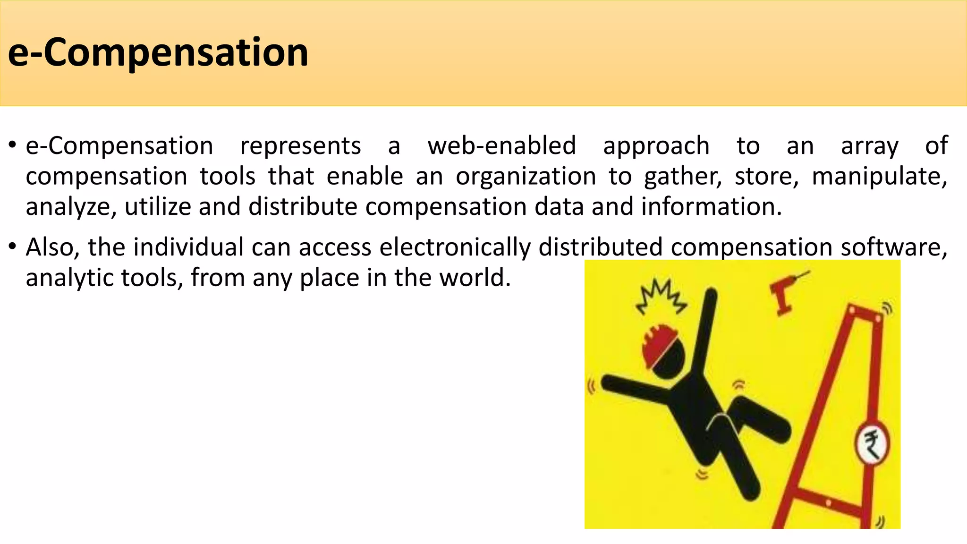

Slide 59
Comparing traditional and electronic HR practices

Slide 60

Unit II: Recruitment and Selection

Slide 61


Slide 62
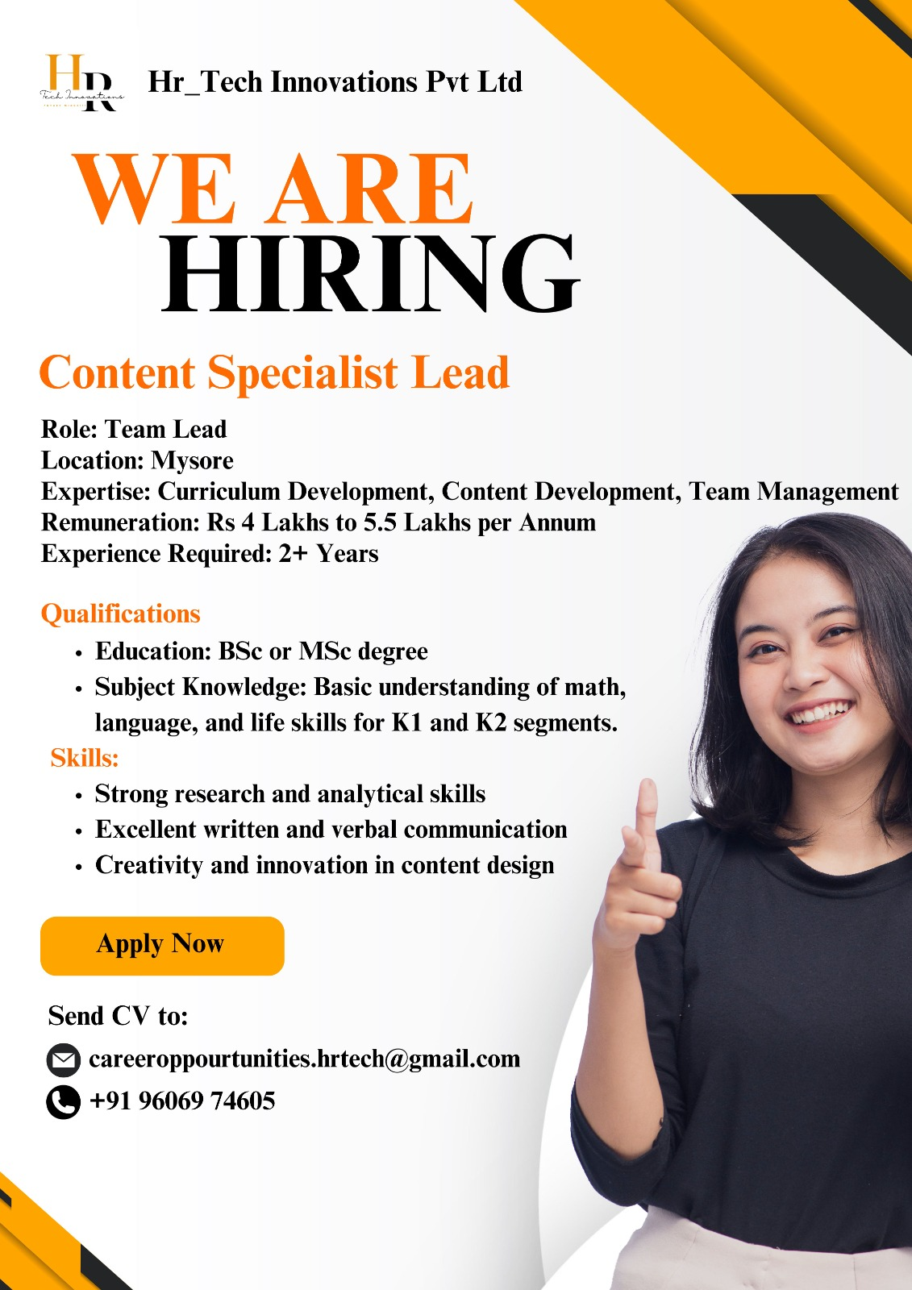

Slide 63
Job analysis
Job analysis as the systematic study of jobs to understand the tasks, duties and qualifications/skills required for a particular job.
According to Edwin B. Flippo – “Job analysis is the process of studying and collecting information relating to the operations and responsibilities of a specific job. The immediate products of this analysis are job descriptions and job specifications.”

Slide 64
Why is job analysis important?
The main objectives of job analysis are as follows:
i. Work Simplification:
Job analysis provides the information related to job and this data can be used to make process or job simple. Work simplification means dividing the job into small parts i.e. different operations in a product line or process which can improve the production or job performance.
ii. Setting Up of Standards:
Standard means minimum acceptable qualities or results or performance or rewards regarding a particular job. Job analysis provides the information about the job and standard of each can be established using this information.
iii. Support to Personnel Activities:
Job analysis provides support to various personnel activities like recruitment, selection,training and development, wage administration, performance appraisal, etc.

Slide 65
A job analysis should focus on the following aspects
Duties and tasks:
Environment:
Tools and equipment:
Relationships:
Requirements:

Slide 66
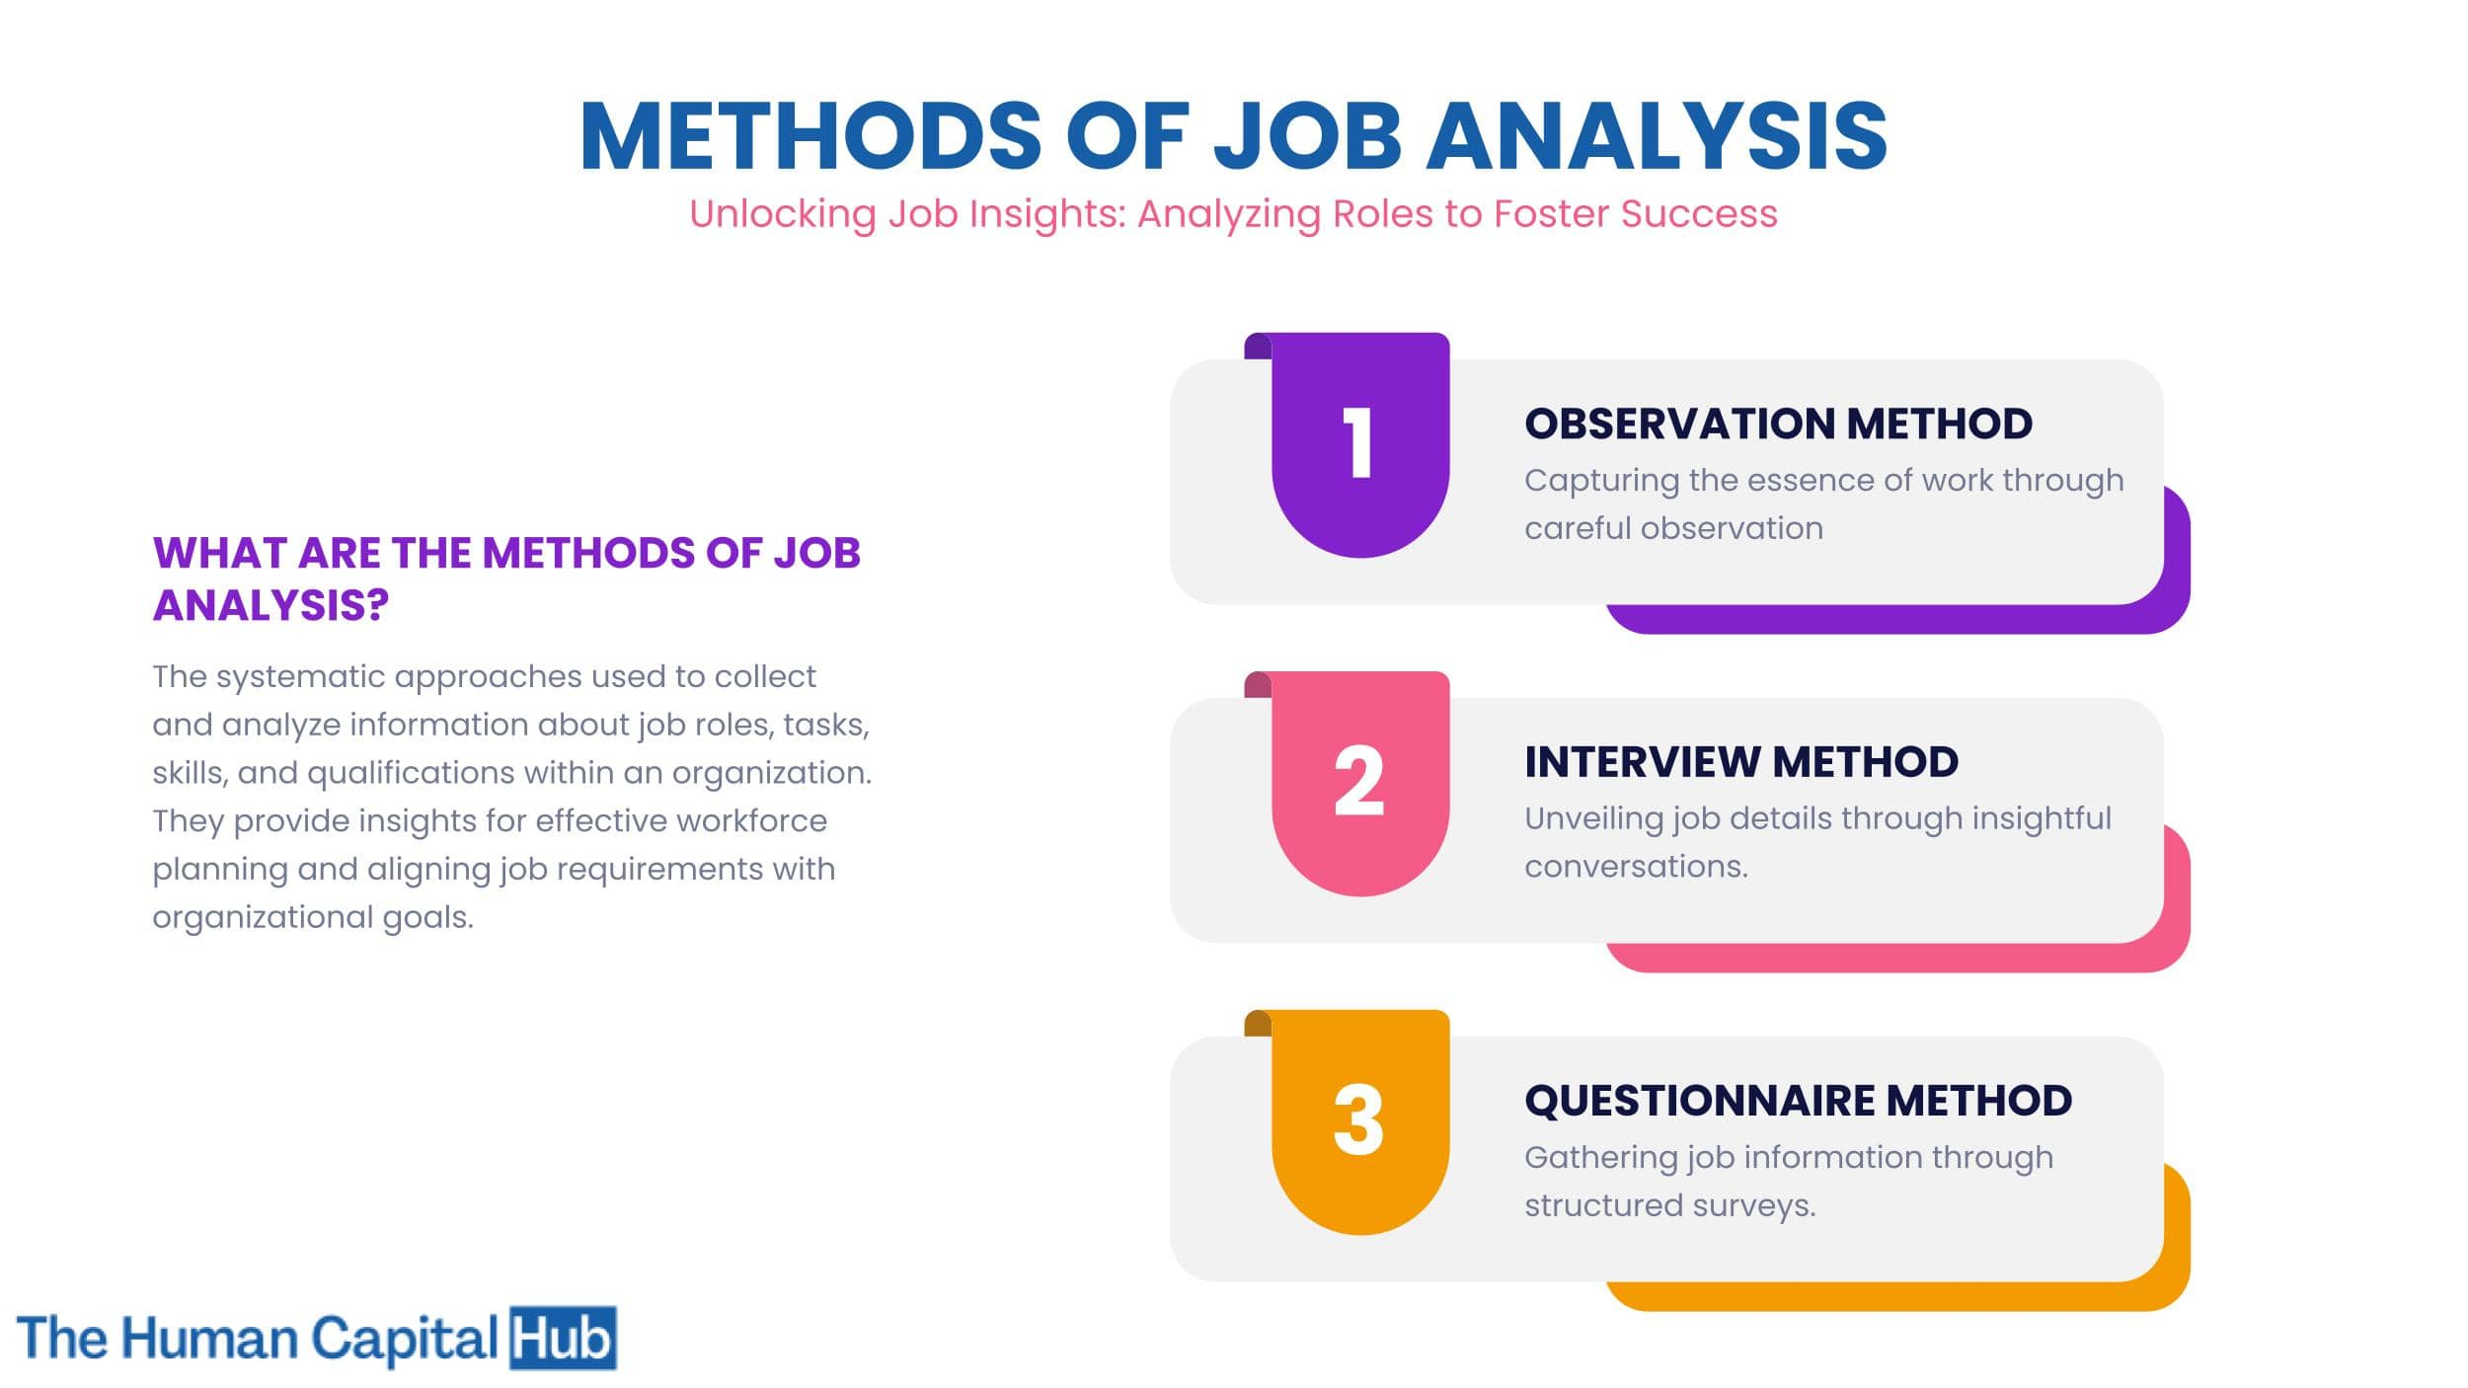
What are the methods of job analysis?

Slide 67
1. Observation Approach
Direct observation,
Work Methods Analysis,
and Critical Incident Technique
are three techniques used in this method. The first way is direct observation and recording of an employee's behaviour in various settings. The second is for assembly-line or manufacturing employees and incorporates the study of time and motion. The third is about finding the work behaviours that lead to success.
2. Interview Technique:
An interview method is a good tool for job analysis since it allows you to pose questions to incumbents and supervisors one-on-one or in a group. Structured interviews, unstructured interviews, and open-ended inquiries are all types of interviews.
3. Questionnaire Method:
The questionnaire method is perhaps the most commonly used job analysis method. The jobholders are given a well-designed questionnaire to elicit essential job-related information. The questionnaires are given to supervisors once they have been completed.

Slide 68
job description and job specification
A job description is a document that states an overview of the duties, responsibilities, and functions of a specific job in an organisation.
A job specification is a statement of the qualifications, personality traits, skills, etc. required by an individual to perform the job.

Slide 69
A job description usually lists out the job title, location, job summary, working environment, duties to be performed on the job, etc.
A job specification lists out the qualifications, experience, training, skills, emotional attributes, mental capabilities of an individual to perform the job.

Slide 70
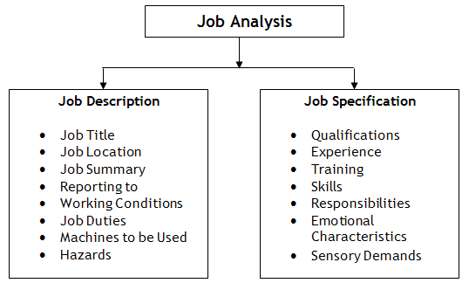

Slide 71

Job satisfaction
Job satisfaction refers to employees’ overall feelings about their jobs. It is the state of well-being and happiness of a person concerning performance in the workspace and its environmen

Slide 72
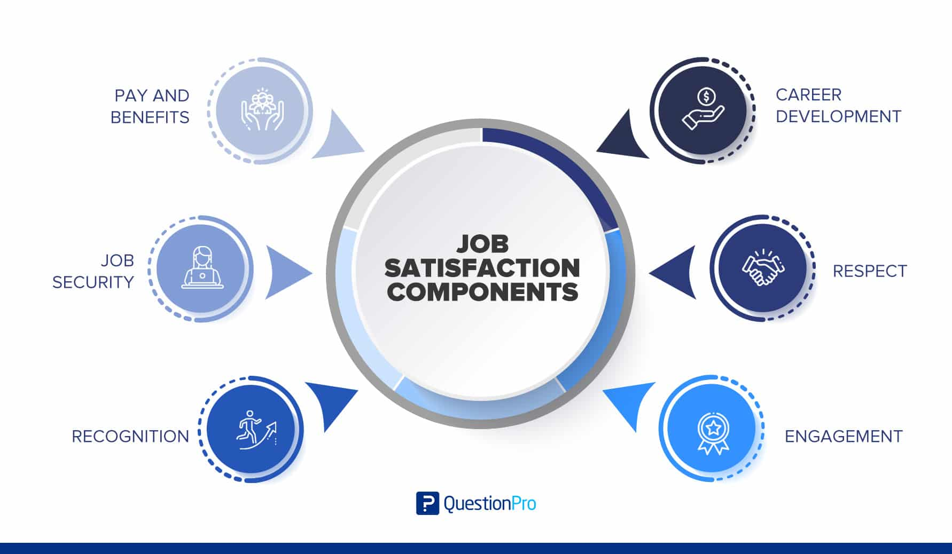
Job satisfaction components

Slide 73
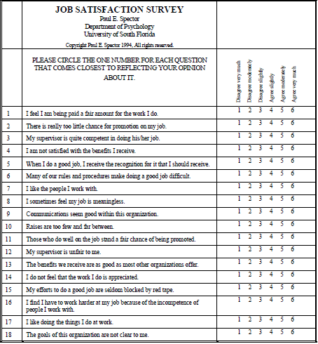

Slide 74
Technique # 1. Job Rotation:
Job rotation implies the shifting of an employee from one job to another within a working group. It aims at adding variety and reducing boredom by introducing a variety of tasks in the existing work profile of employees. Job rotation is also known as the horizontal transfer of an employee to a job of same level and status.

Slide 75
Technique # 2. Job Enlargement:
Job enlargement refers to the process of increasing the scope of a particular job by adding more tasks and duties to it. It means assigning varied tasks or duties to the employees at the same level. In other words, job enlargement intends to add similar tasks or activities to the existing work profile of employees to make their jobs more interesting.

Slide 76
Technique # 3. Job Enrichment:
Job enrichment consists of designing a job in such a way that the employees get greater autonomy in planning, decision-making, and controlling. The greatest motivation for the employees is the opportunity for achievement, recognition, responsibility, and growth.

Slide 77
Job Rotation
Job rotation implies systematic movement of employees from one job to the other for job design. Job remains unchanged but employees performing them shift from one job to the other.
Job Enlargement
Job enlargement means expanding the scope of the job Many tasks and duties are aggregated and assigned to a single job.
It is also the horizontal expansion of a job. It involves the addition of tasks at the same level of skill and responsibility adding more tasks and responsibilities to an employee’s existing role

Slide 78
job enrichment
The central focus of job enrichment is giving people more control over their work
Job Enrichment also for decentralization of decision making rights to individual over areas that directly affect his task functions.

Slide 79
What is job enlargement?
Job enlargement involves expanding the scope of an employee's job by adding more tasks and responsibilities.
These additional tasks may involve different aspects of the same job or related tasks that require similar skills and knowledge.
The primary objective of job enlargement is to provide employees with a broader range of job activities, reducing monotony and increasing motivation and satisfaction.

Slide 80
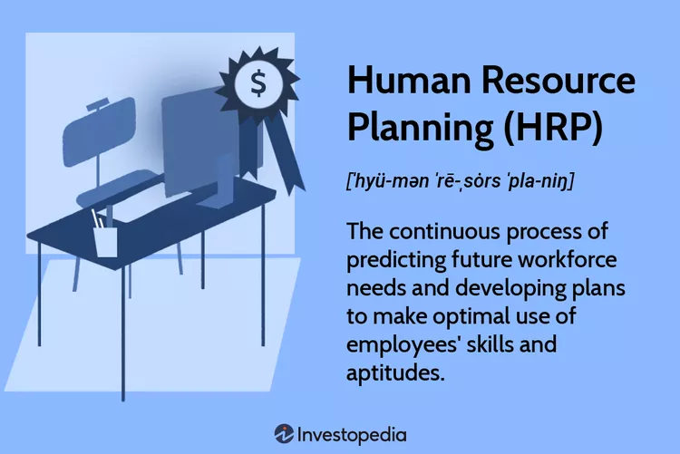
Human Resource Planning (HRP)

Slide 81
What Is the Goal of Human Resource Planning (HRP)?
The goal of HR planning is to have the optimal number of staff to make the most money for the company. Staying on top of this and achieving effective HRP can ensure that the company:
Gets the best out of current employees and increases their value
Has a competitive advantage in its industry
Is better placed to respond to challenges and adapt to changes

Slide 82
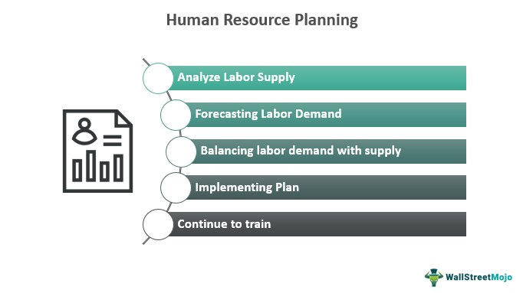

Slide 83
Four Steps to Human Resource Planning (HRP)
1. Analyzing Labor Supply
The first step of HRP is to identify the company's current human resources supply. In this step, the HR department studies the strength of the organization based on the number of employees, their skills, qualifications, positions, benefits, and performance levels.
2. Forecasting Labor Demand
The second step requires the company to outline the future of its workforce.The HR department can also look at external conditions impacting labor demand, such as new technology that might increase or decrease the need for workers.
3. Balancing Labor Demand With Supply
The third step in the HRP process is forecasting the employment demand. HR creates a gap analysis that lays out specific needs to narrow the supply of the company's labor versus future demand.

Slide 84
4. Developing and Implementing a Plan
The answers to questions from the gap analysis help HR determine how to proceed, which is the final phase of the HRP process.

Slide 85
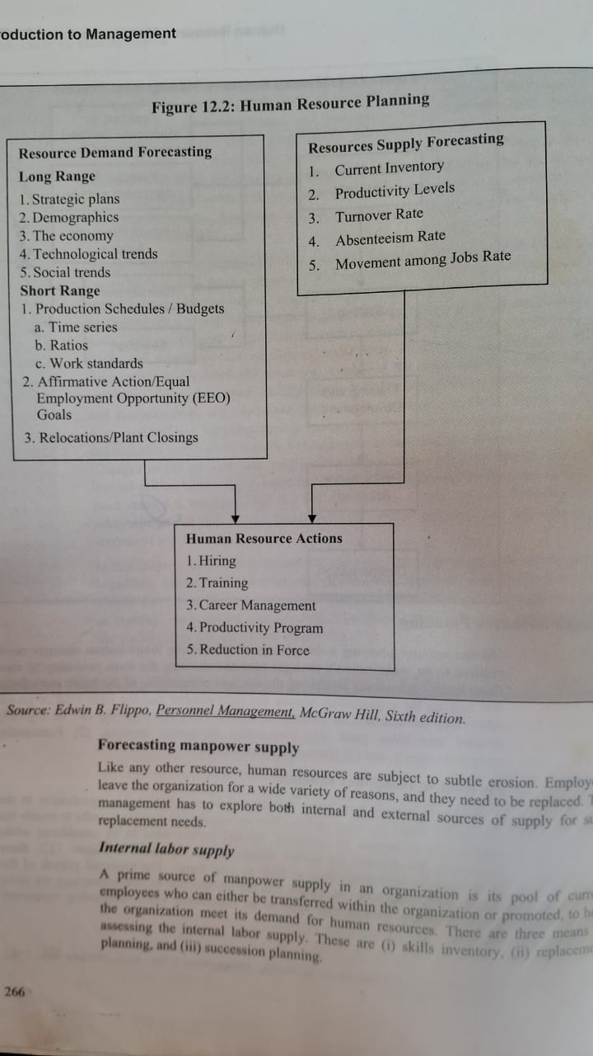

Slide 86
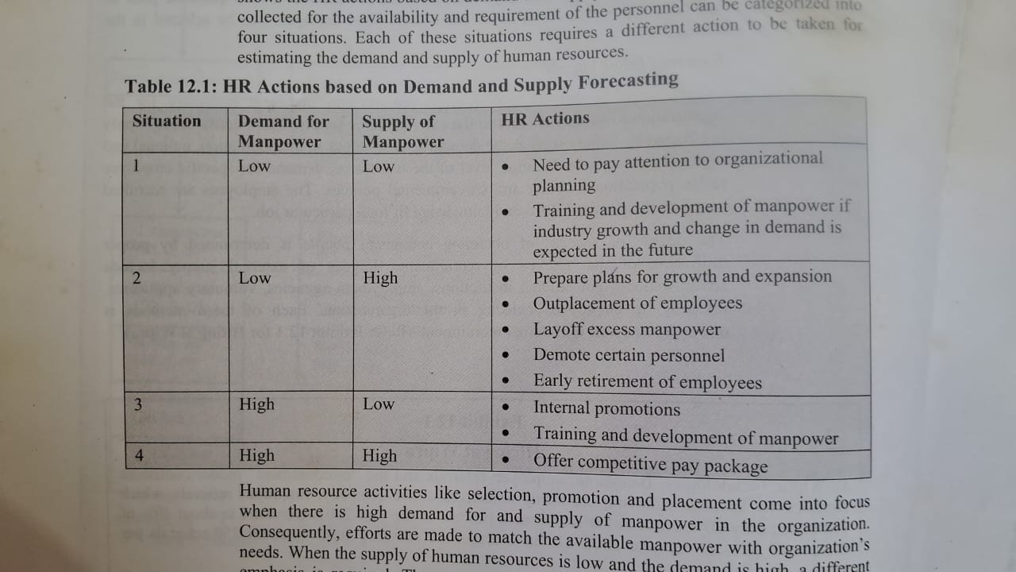

Slide 87
Recruitment
Definition:
According to Edwin B. Flippo, “It is a process of searching for prospective employees and stimulating and encouraging them to apply for jobs in an organisation.”
Kempner writes, “Recruitment forms the first stage in the process which continues with selection and ceases with the placement of the candidates.”

Slide 88
Sources of recruitment
Sources of recruitment refers to various modes of connecting with the job seeker for completing the task of finding potential employees. In simple words, sources of recruitment is the medium through which communication regarding the vacant positions is made aware to the prospective candidates.
There are generally recognised two sources of recruitment, which are internal and external sources. Let us discuss these sources in detail in the following lines.

Slide 89
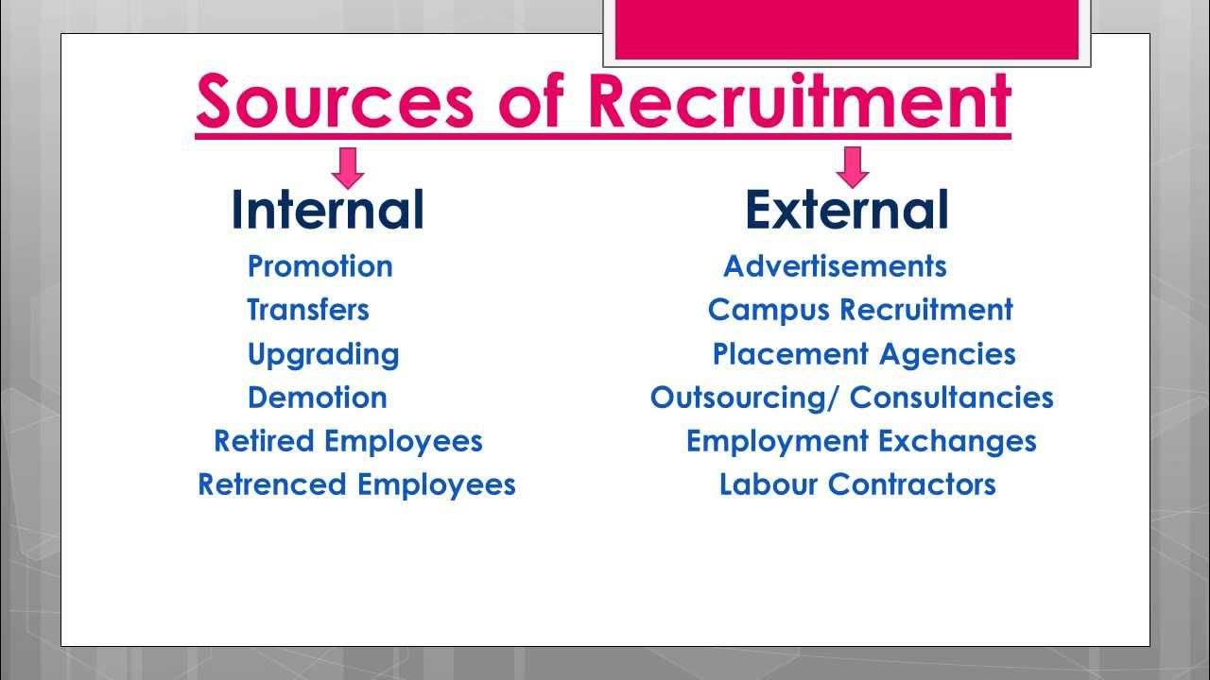

Slide 90
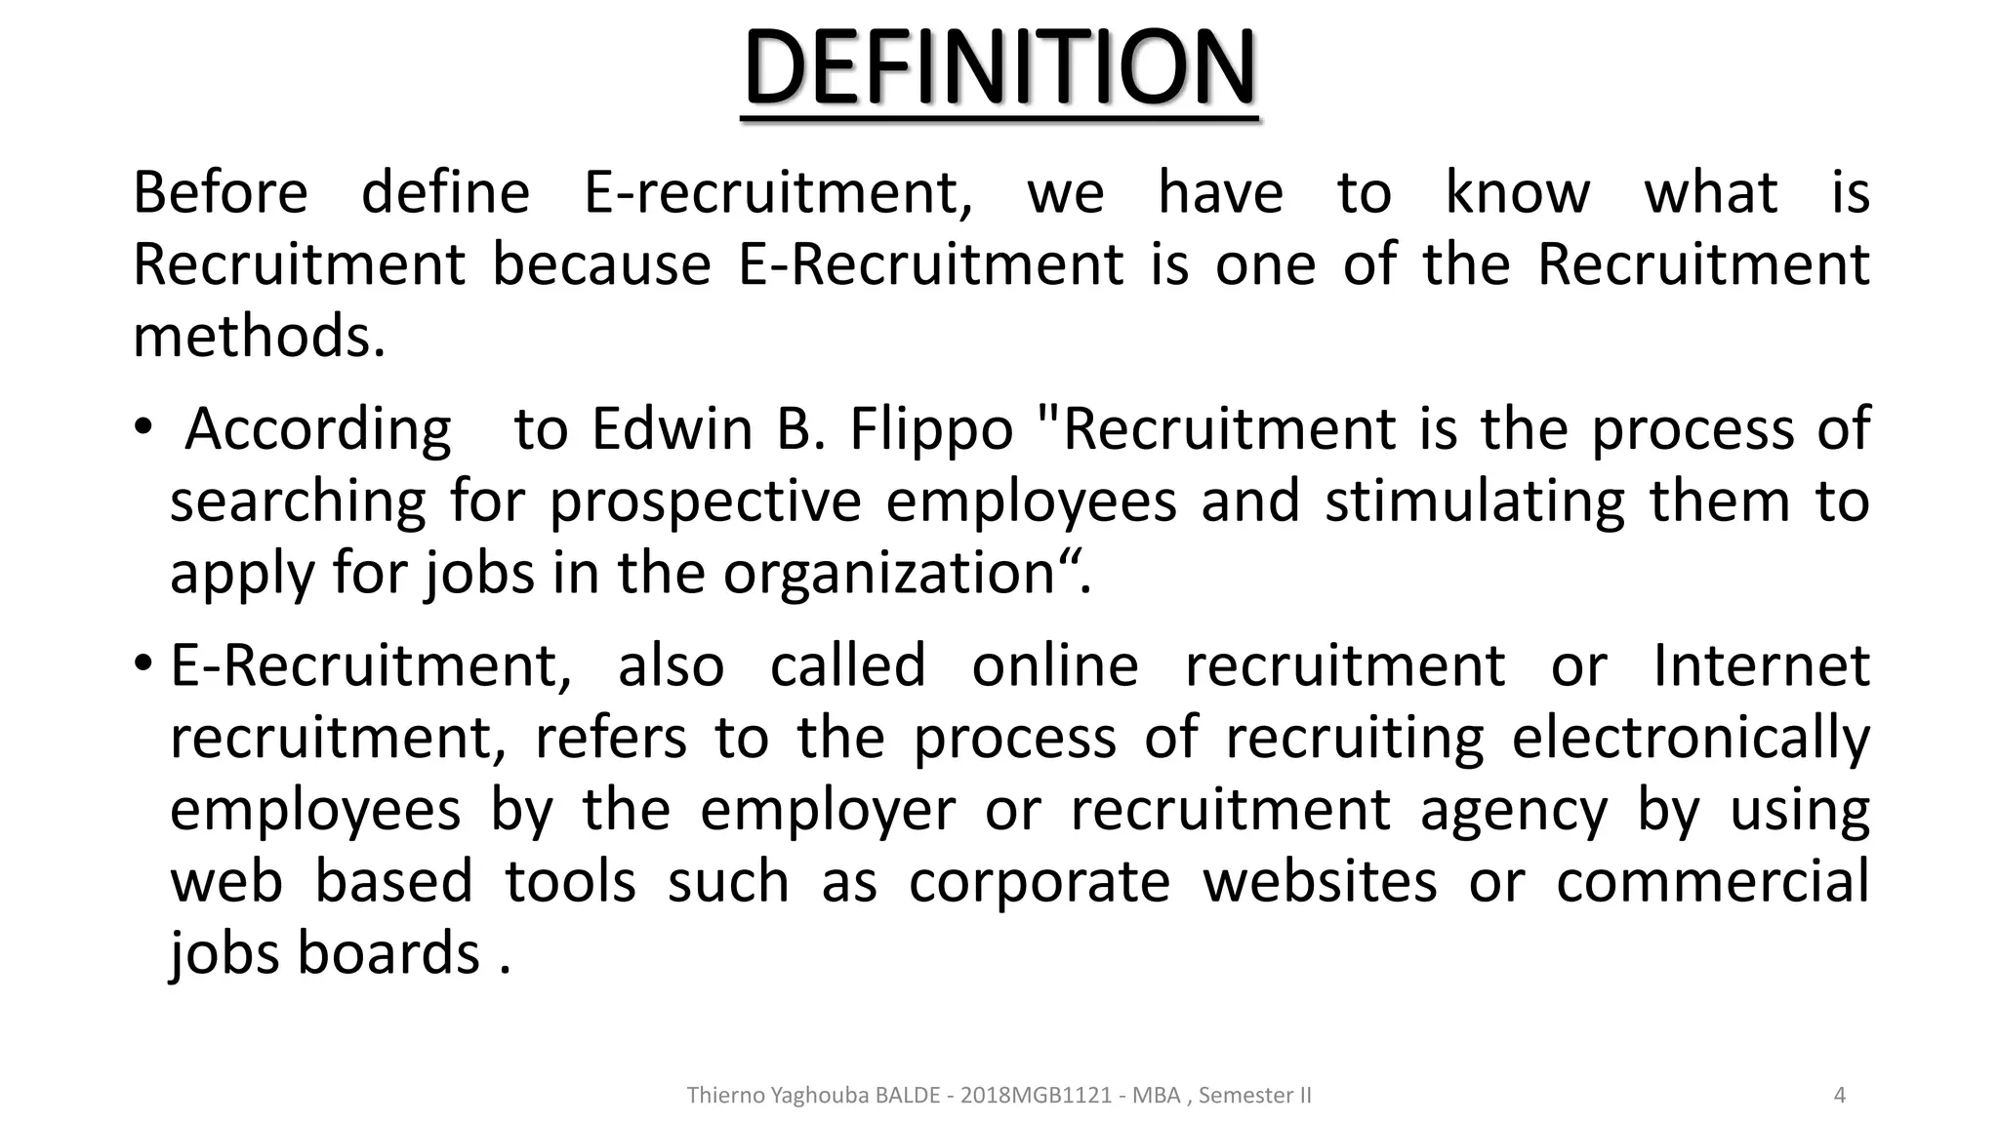
E-Recruitment

Slide 91
E-Recruitment
E-recruitment, also known as online recruitment, refers to the use of web-based technology for the various processes of attracting, assessing, job candidates.
E-recruitment is an integration and use of internet technology to improve competence of recruitment process.

Slide 92
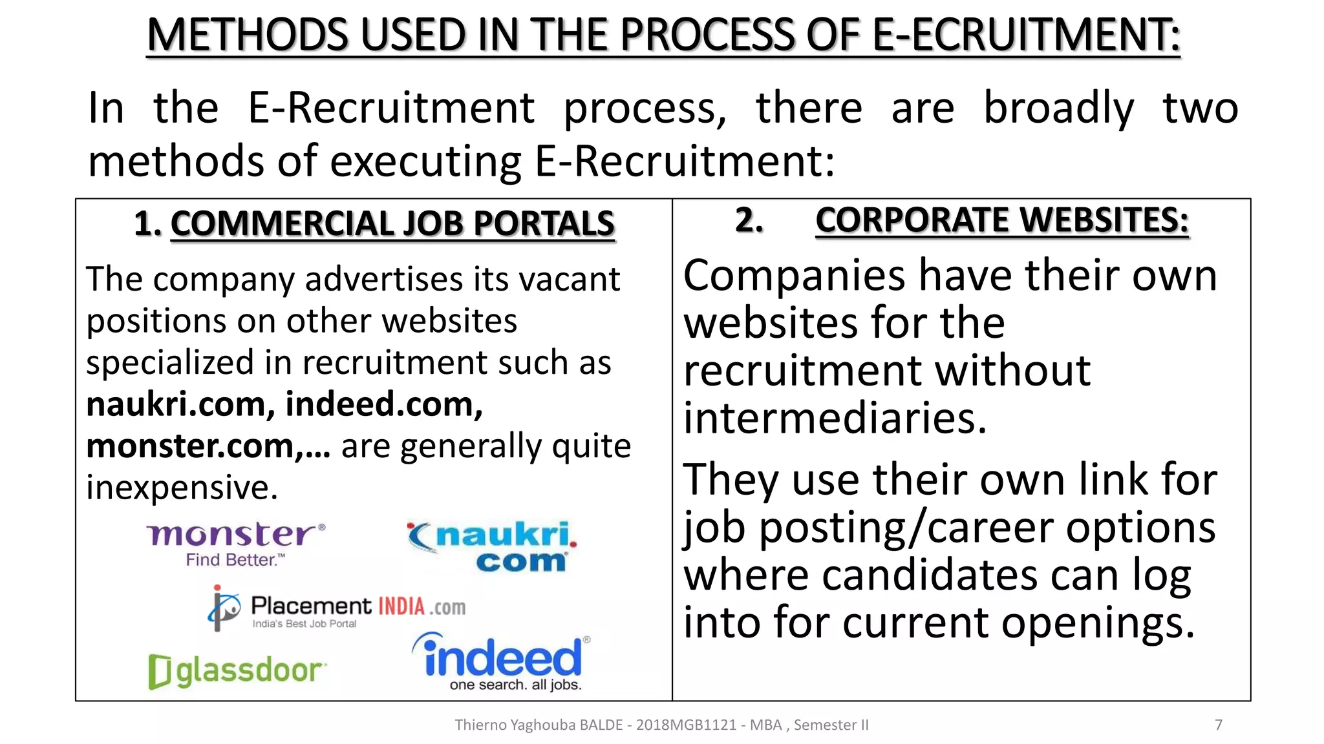

Slide 93
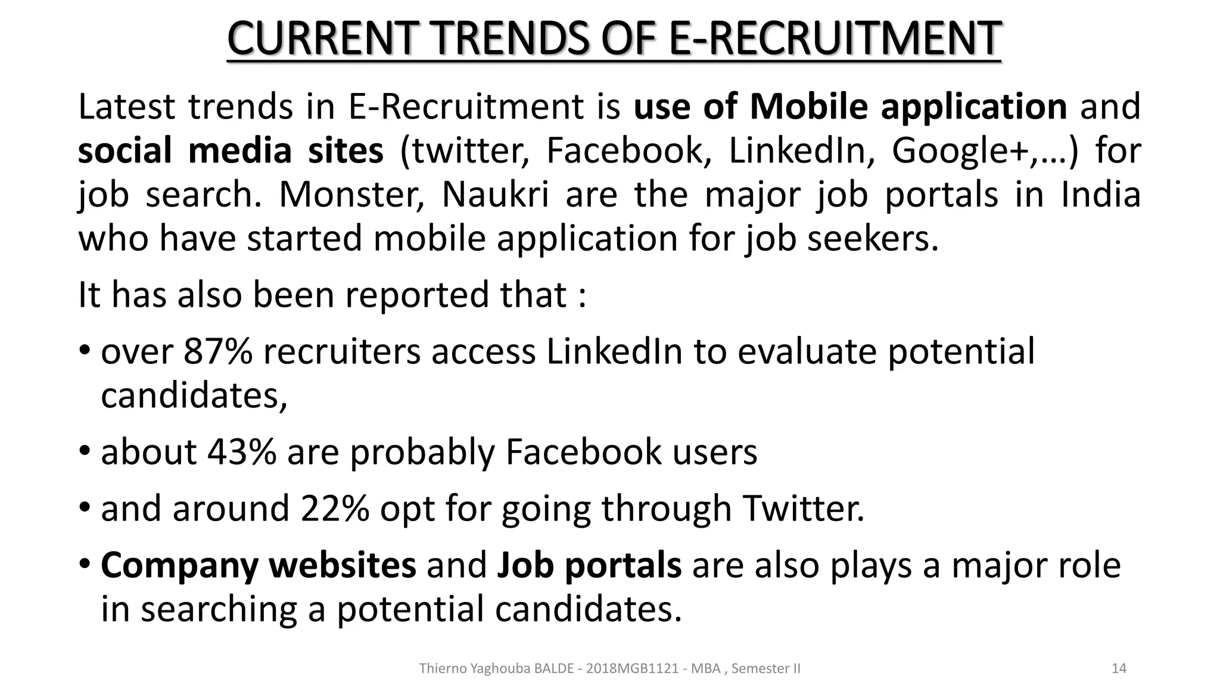

Slide 94
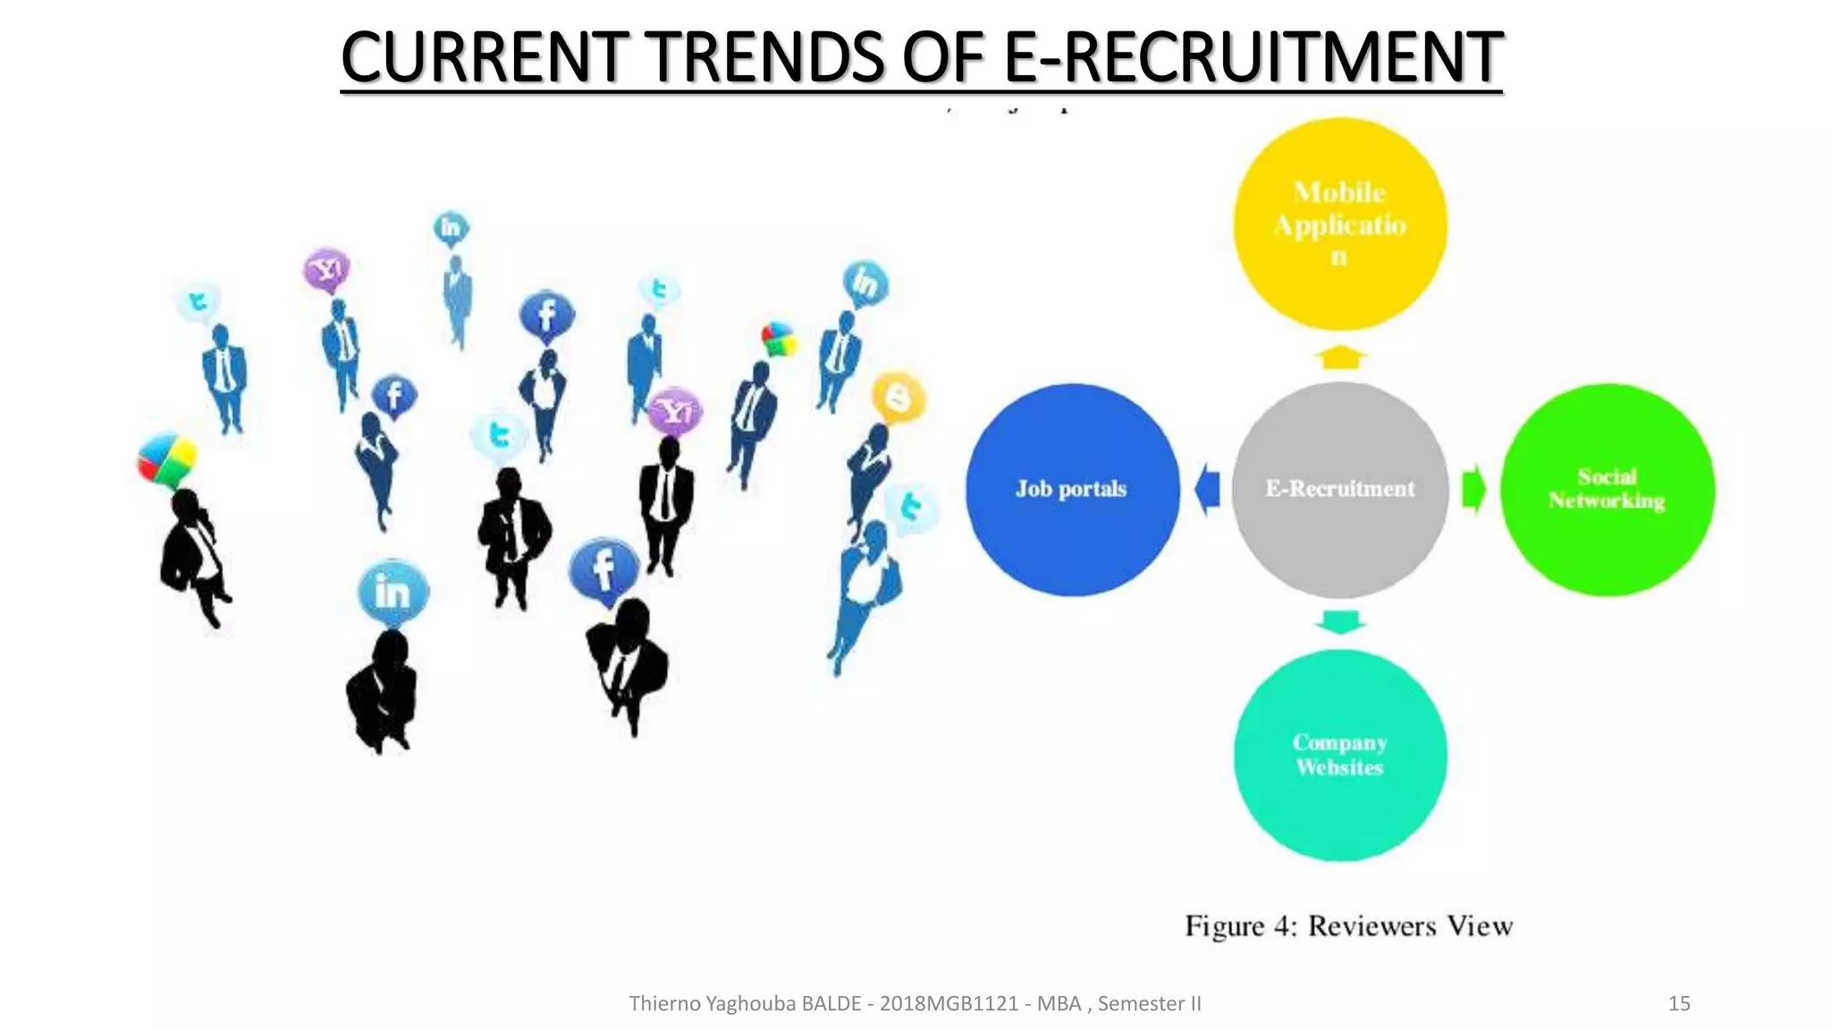

Slide 95
Selection Process
The selection process can be defined as the process of selection and shortlisting of the right candidates with the necessary qualifications and skill set to fill the vacancies in an organisation.
The selection process varies from industry to industry, company to company and even amongst departments of the same company.

Slide 96

Selection
Definition: Selection is the procedure of choosing persons who have appropriate qualifications to occupy jobs in the company.

Slide 97
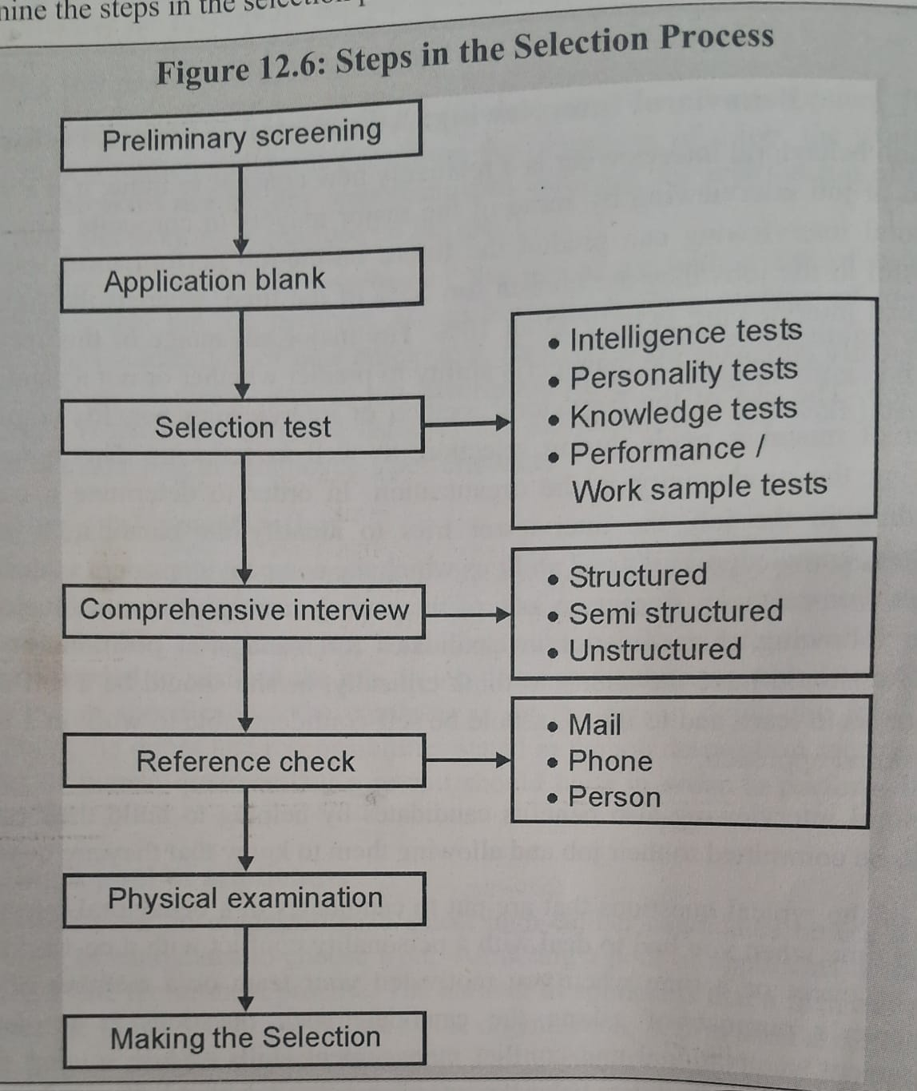

Slide 98
Definition of Interview
An interview is an interpersonal communication technique for exchanging ideas between two people. The word “interview” derives from the French word “entrevue” or “entrevior,” which means “to see one another” or “to meet”
Gary Dessler states, “Interview is a selection procedure designed to predict future job performance based on applicants’ responses to oral inquiries.”

Slide 99

In English, it means ‘a view between’ or ‘a sight between.’ It suggests that an interview is a meeting between two people for the purpose of getting a view of each other or for getting to know each other.

Slide 100
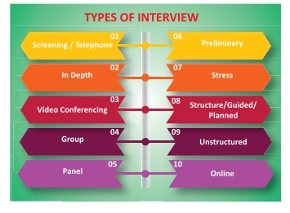

Slide 101
1) Screening / Telephone Interview
Where the candidates live far away from organization and find it difficult to attend preliminary interview for various reasons, telephone interview is conducted by some organization to eliminate unfit and unsuitable candidate at the preliminary stage itself.
02) In depth Interview
This interview is conducted to test the level of knowledge of the interviewee in a particular field intensively and extensively. Thus interview helps the interviewers to learn about the candidate’s expertise and practical exposure with respect to his/her area of specialization.
03) Video Conferencing Interview
Video conferences interview is similar to face to face interview. Video conferencing interview is a kind of conference call that connects the candidate with companies located across various geographies. Just like telephone call a video conferencing interview has multi point which allows two or more people in different locations to participate in the interview process. Interview can be conducted from a desktop at work, a home computer or smart phone or a tablet.
.

Slide 102
04) Group interview
A group interview is a screening process where multiple candidates are interviewed at the same time. Group interview is a good time saving type of interview. Instead of spending 5 hours interviewing 5 candidates individually, one hour can be spent interviewing them in a group. Some time particular topic is given to the group, and they are asked to discuss it. The competency of members of group is assessed by keenly observing the participation of members in the discussion.
05) Panel Interview
Where a group of people interview the candidate, it is called panel interview. Usually panel comprises chair person, subject expert, psychological experts, representatives of minorities/underprivileged groups, nominees of higher bodies and so on. All panel members ask different types of questions on general areas of specialization of the candidate. Each an every member awards marks for the candidate separately. At the end, the marks awarded by all the members are aggregated and the candidates are ranked accordingly. This method eliminates bias in selection process. It ensures more reliability in the selection of the candidate.

Slide 103
06) Preliminary Interview
This interview is conducted to know the general suitability of the candidates who have applied for the job. Team of experts conducts their interview primarily to eliminate those who are unqualified and unfit candidates. This helps the employer organization to cut cost and time in selection process.
07) Stress Interview
This type of interview is conducted to test the temperament and emotional balance of the candidate interviewed. Interviewer deliberately creates stressful situation by directing the candidate to do irrational and irritating activities. They assess the suitability of the candidate by observing the reaction and response of the candidate to the stressful situations. Mostly this type of interview is conducted for recruiting sales representatives staff for defence and law enforcement agencies.
08) Structure/Guided/Planned Interview
Under this method, a series of question to be asked by the interviewer are pre-prepared by the interviewer and only these questions are asked in the interview. Ultimately interviewees are ranked on the basis of score earned by the candidate in the interview.

Slide 104
09) Unstructured Interview
This is quite contrary to structured interview. An atmosphere for free and frank interaction is created in the interview environment. There is no pre-prepared questions. Interviewers determine the suitability of the candidate based on their response to the random questions raised in the interview.
10) Online Interview
Due to tremendous growth in information and communication technology, these days interviews are conducted by means of internet via Skype, Wechat, Google duo, Viber, Whatsapp or Video chat applications. This enables the interviewers to conduct interview with the candidates living in faraway places. They saves a lot of time, money and energy both for employer's organisation and the candidate
11) Exit interview
Unlike other types of interviews, exit interview allows companies to gain a perspective on why employees leave their job. Employers interview employees to share their feedback on their work experience at the company. Based on the feedback, the company can make improvements within the workflow.

Slide 105
Errors in Interviews
✓ Snap judgements: deciding the applicant's suitability
quickly based on the early impression
✓ Leniency: the tendency to rate employee high or excellent on all criteria
✓ Stereotyping: attributing characteristics to individuals
based on their inclusion or membership in a particular group
✓ Bias: allowing the ratings to be influence by the personal likes and dislikes
✓ Halo effect: a single important trait of a candidate affects the judgement of the rater
(like “athletes make good sales people”)
✓ Candidate order error: the order in which a rater interviews candidates could influence ratings sometimes.

Slide 106
Unit – III: Training and Development

Slide 107
Training
:
Training is a systematic process of developing employee skills and knowledge to improve their job performance. The employer organises training for his employees to increase their job knowledge, skills and improve their attitude and knowledge.
Definition: Edwin B. Flippo, ‘’Training is the act of increasing the knowledge and skills of an employee for doing a particular job.’’

Slide 108
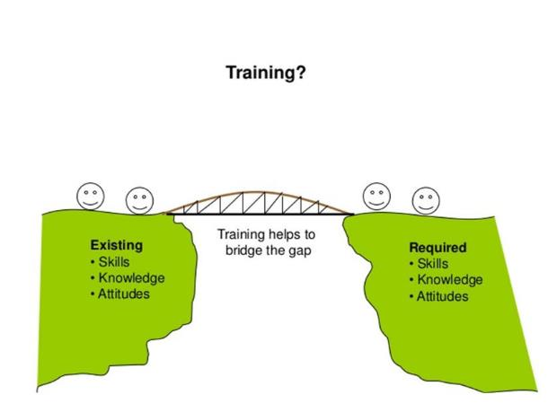

Slide 109
Importance of Training and Development Programs
1. Feedback from trainees: Interviews can be conducted or
questionaries’ can be circulated among trainees to now their opinion
about training programmes.
2. Learning: An important objective of training is to ensure learning of new skills and knowledge.
3. Changes in Attitude and Behaviour: Training should create positive changes in the attitude and behaviour of employees it should improve the interest in the job commitment and willing ness to put in their best efforts.

Slide 110
4. Other outcomes: The other outcomes of training an development
A. Improvement in Production and Productivity
B. Quality Improvement
C. Reduction in Wastages
D. Decline in Absenteeism
E. Reduction in Labour Turnover
F. Improved Quality of Decisions
G. Better Analytical Skills
H. Improved Conceptual Skills
I. Capacity for Career Growth
J. Reduction in Accident Rate
K. Better Relation among members of the organisations
L. Improved Team Spirit and Employee Engagement
M.Improved Rate of Innovation
N. Better Capacity to Adopt to Implement Change.

Slide 111
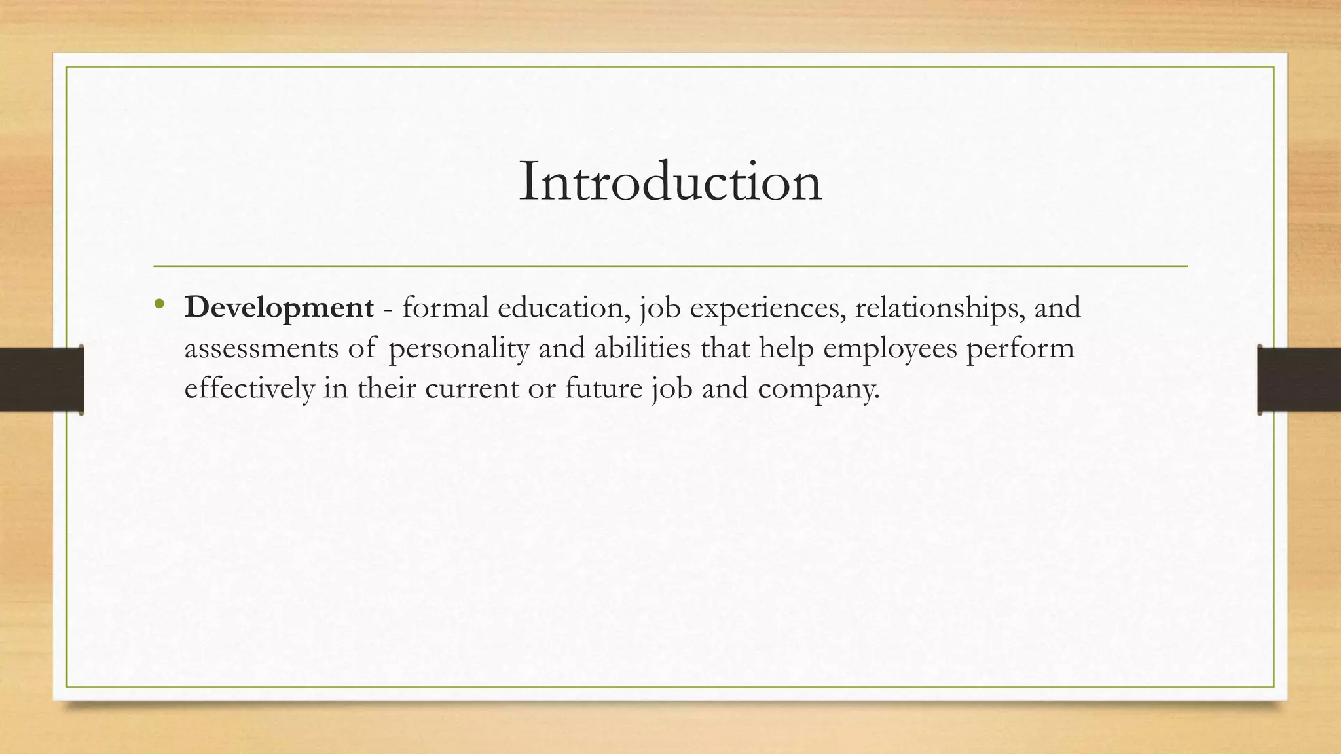

Slide 112
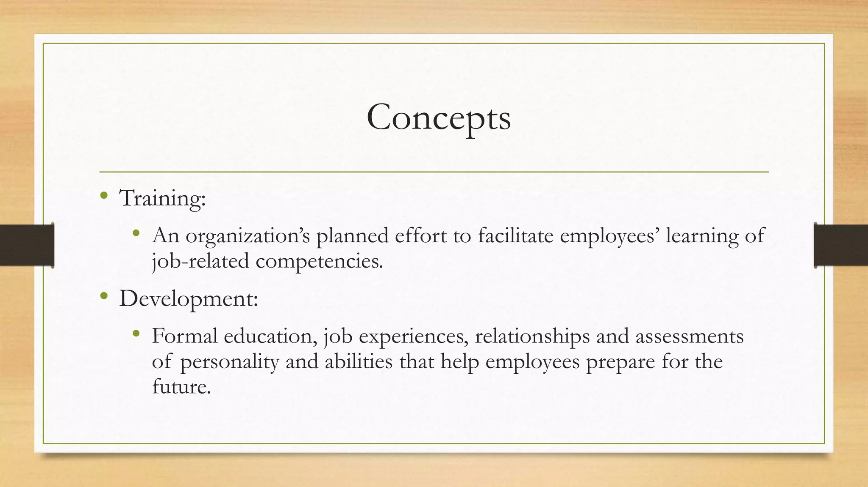

Slide 113
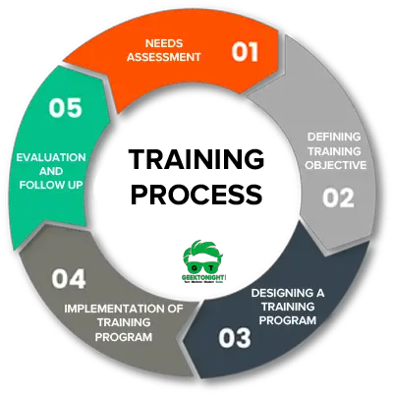

Slide 114
Needs Assessment
The first step in the training process is to assess the need for training the employees. It analysis what are the long term requirements of the organization and what does the organization expects from the employees.
If there is a mismatch between the skills and knowledge required, it means there is a learning gap. To assess this learning gap below three elements is closely examined.
Defining Training Objective
After deriving the learning gap organizations should define the learning objective. Goals and objective of training becomes the foundation of the training initiatives.
Hence determining the training objectives gives a direction to the entire learning program.

Slide 115
Designing a Training Program
Once the objective of the training program is determined, it is time to analyze the factors that need to be considered while designing a training program.
Implementation of the Training Program
Refers to putting the training plan into action. There should be a proper environment created which is conducive to learning. It should be preferably a participative approach and trainer should promote role-playing and interactive games to keep the trainees involved

Slide 116
Evaluation and Follow up
Training evaluation is done to check whether the goals and objectives of the training have been achieved or not. Feedback needs to be taken from the participants on the training results.
A follow up can be done by asking the supervisors whether the participants are applying the skills learned in the learning program on their day to day job.

Slide 117
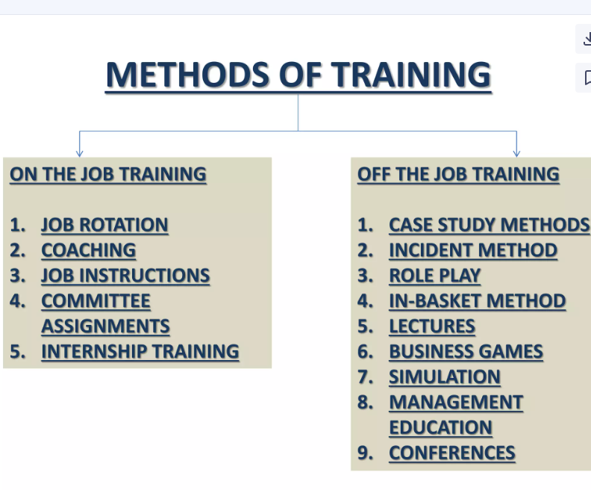

Slide 118
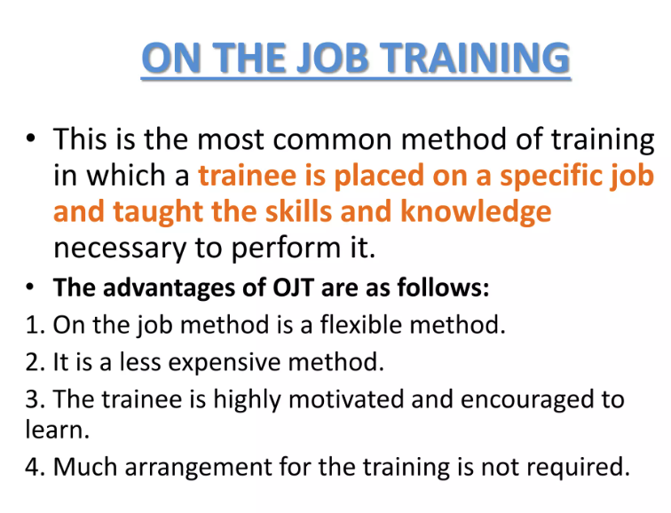

Slide 119
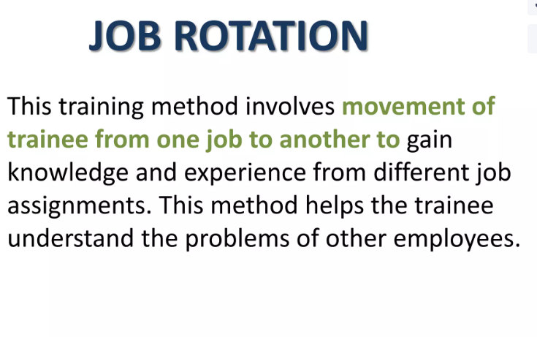

Slide 120
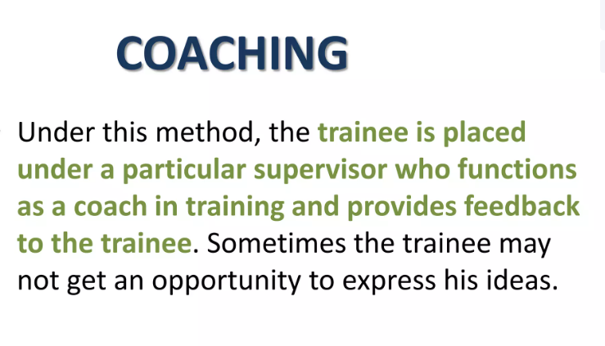

Slide 121
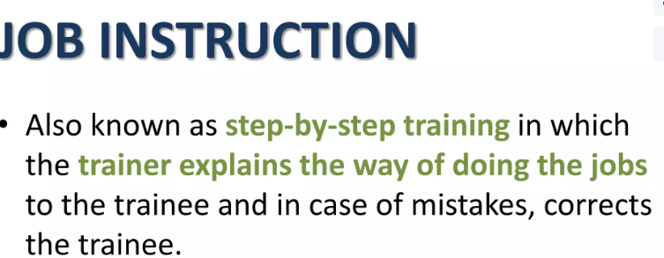

Slide 122
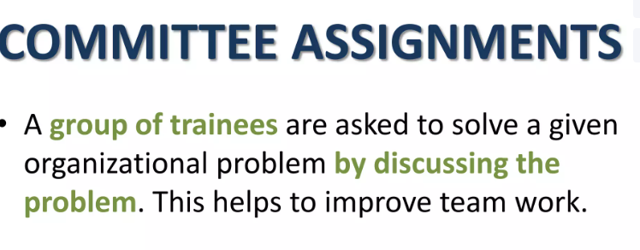

Slide 123
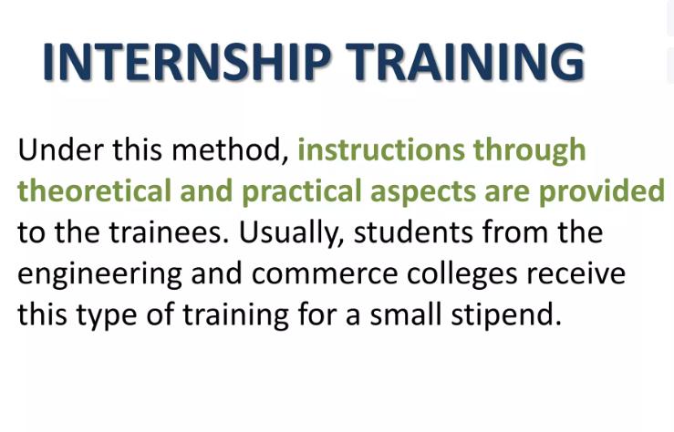

Slide 124
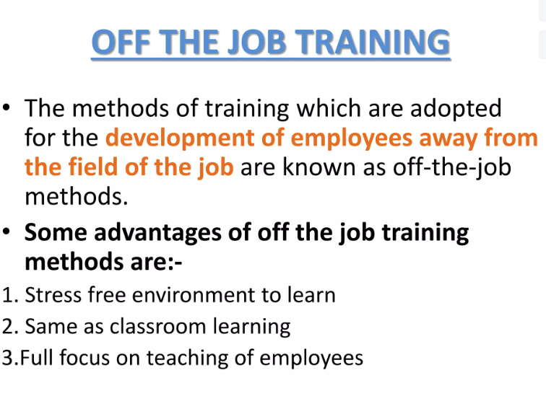

Slide 125
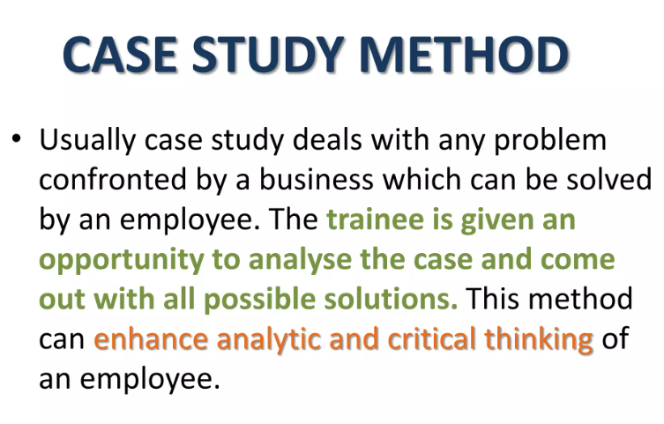

Slide 126


Slide 127


Slide 128


Slide 129


Slide 130
Simulation
image of Simulation
A simulation is an imitative representation of a process or system that could exist in the real world. In this broad sense, simulation can often be used interchangeably with model.

Slide 131


Slide 132


Slide 133


Slide 134

Difference

Slide 135
Training and development are both important for organizations, but they differ in their purpose, scope, and focus:
Training
A short-term process that focuses on teaching employees specific skills and knowledge for their current role. Training is often led by experts and trainers, and it can help build employee confidence.
Development
A long-term process that focuses on an employee's overall growth and potential. Development can help employees progress in their careers, and it can involve a wider scope than training.
Here are some other differences between training and development:
Focus: Training focuses on technical skills, while development focuses on conceptual and human ideas.
Orientation: Training is job-oriented, while development is career-oriented.
Level: Training is meant for supervisors and trainees, while development is meant for managerial levels.

Slide 136


Slide 137
What is management development?
What is management development?
Management development is the process of developing the skills and competencies needed to perform in management positions, either in existing managers or those new to management. It may also be referred to as leadership development or executive education.
To look at it from another perspective, management development is a continuous, systematic process that helps employees reach their full potential by building on strengths, managing weaknesses, and exploring career development opportunities.

Slide 138


Slide 139


Slide 140


Slide 141
Management Development Process
1. Assess Your Organization's Needs
The first step in developing a training program is to identify and assess your organizational needs.
2. Set Clear Development Objectives
The Needs Assessment process above will identify any gaps in your current development initiatives and manager skill sets. These skill gaps should be analyzed, prioritized, and turned into the organization’s development objectives.

Slide 142
3. Design the Management Development Plan
The next step is to design a Comprehensive management training plan.
4. Measure the Results
This is the most important, yet often overlooked step. Most people leaders know they should measure the results, but they lack the method or understanding to do it.

Slide 143
Evaluation of Training and Development programs.
Your measurement should aim to answer these questions:
What was the impact of the management development program on employee performance?
How did it affect employee attitudes?
How effective was it in transferring needed knowledge and skills?
What were the costs, and how do they measure up against the benefits you’ve gained from your management development program?

Slide 144
Methods to evaluate
Gather participant feedback
Gather feedback from other stakeholders
Collect ‘before and after’ data
Evaluate learning outcomes
Evaluate the ROI(Return on investment)

Slide 145
Apple - Steve Jobs: Co-founder Steve Jobs transformed Apple into one of the most valuable companies in the world with innovative products like the iPhone, iPad, and MacBook, focusing on design and user experience.
Amazon - Jeff Bezos: As the founder, Bezos revolutionized e-commerce with Amazon, expanding the business from a bookstore to a global marketplace, and later venturing into cloud computing with Amazon Web Services (AWS).
Tesla - Elon Musk: Musk has driven Tesla's growth by pushing electric vehicle technology and sustainable energy solutions, making the company a leader in the automotive industry and beyond.
Microsoft - Satya Nadella: Since becoming CEO, Nadella has shifted Microsoft’s focus to cloud computing and subscription services, revitalizing the company and increasing its market value significantly.
Netflix - Reed Hastings: Co-founder Hastings transitioned Netflix from a DVD rental service to a leading streaming platform, investing in original content and adapting to changing consumer preferences.

Slide 146

UNIT- IV
Performance Management

Slide 147
Regular Performance Reviews: Companies like Google conduct biannual performance reviews that include peer feedback, self-assessments, and manager evaluations to ensure alignment with company goals.
Goal Setting: Intel uses the OKR (Objectives and Key Results) framework to set clear, measurable goals for teams and individuals, promoting transparency and accountability.
Continuous Feedback: Adobe replaced annual reviews with ongoing feedback through its "Check-In" system, allowing managers and employees to have regular, informal discussions about performance and development.
360-Degree Feedback: General Electric (GE) employs 360-degree feedback, gathering input from peers, subordinates, and managers to provide a comprehensive view of an employee’s performance.
Performance Metrics and Dashboards: Salesforce utilizes performance dashboards that track key performance indicators (KPIs) in real-time, helping employees and managers stay informed about progress.
Personal Development Plans: Accenture focuses on individual development plans that align personal goals with organizational objectives, facilitating career growth and skills enhancement.
Recognition Programs: Zappos has a peer recognition program where employees can reward each other for exceptional performance, fostering a positive work culture.
Training and Development: IBM emphasizes continuous learning and development opportunities, integrating performance management with training programs to support skill enhancement.
Succession Planning: Microsoft incorporates succession planning into its performance management process to identify and develop future leaders within the organization.

Slide 148
What is Performance Management?
An ongoing, continuous process of communicating and clarifying job responsibilities, priorities, performance expectations, and development planning that optimize an individual's performance and aligns with organizational strategic goals.

Slide 149
Performance management is defined as the process of continuous communication and feedback between a manager and employee towards the achievement of organizational objectives.

Slide 150
concept of performance management and appraisal
Performance management and performance appraisal are both processes that help organizations evaluate and improve employee performance
Performance management is about actually helping an employee to develop and increase his performance and productivity. Performance appraisal evaluates the actual performance of the employee, but it does not focus on the employee's performance productivity

Slide 151
OBJECTIVES OF PERFORMANCE MANAGEMENT
PERFORMANCE FEEDBACK
PERFORMANCE IMPROVEMENT(training and development)
IDENTIFICATION OF POTENTIAL
PROMOTION DECISIONS
COMPENSATION ADMINISTRATION WORK FORCE PLANNING
VALIDATION OF SELECTION PROCEDURES

Slide 152
What Is a Performance Appraisal?
A performance appraisal is a structured and regular review/ assessment of an employee's job performance, assessing how well their work aligns with the set job criteria.

Slide 153

The Performance Appraisal Process

Slide 154

Techniques for Performance Appraisal

Slide 155


Slide 156


Slide 157


Slide 158


Slide 159


Slide 160


Slide 161


Slide 162


Slide 163


Slide 164


Slide 165
1. Management by Objectives (MBO)
In this method, managers and employees collaborate together to identify, plan, organize, and communicate objectives. This is usually for a specific appraisal period and objectives are validated using the SMART (Specific, Measurable, Achievable, Realistic & Time-sensitive) method.

Slide 166
2. 360-Degree Feedback Method
The method focuses on collecting feedback from everyone an employee interacts with like managers, customers, peers, etc. When data is collected from multiple sources, the chances of a manager’s bias affecting the appraisal are eliminated. Plus, it offers a clearer picture of the employee’s competence in terms of work.

Slide 167


Slide 168
3. Assessment Center Method
Introduced by the German Army in the 1930s, the concept of assessment center has been revamped to suit the current business scenario. The employees are assessed based on their performance like social-stimulating exercises like role-playing, decision-making, informal discussions, etc. The assessment evaluates the performance of employees to identify future leaders and managers.

Slide 169
4. Human Resource Accounting Method
Also known as Human Resource Cost Accounting Method, it is used to evaluate an employee’s performance as per the monetary benefits they yield from the organization. This means the performance of an employee is compared against the salary & other costs the company pays to the employee.

Slide 170
5. Behaviorally Anchored Rating Scale (BARS)
In this modern method of performance appraisal, both the qualitative and quantitative aspects of an employee are evaluated. BARS compares an employee’s performance with specific behavioral examples that are assigned a numerical rating. As per employee’s role and job-level, BARS has a set of predetermined standards called BARS statements. These statements are used as yardsticks to measure the performance on each BARS scale level.

Slide 171
Here’s a real-world example of how Behaviorally Anchored Rating Scales (BARS) might be implemented in a customer service department:
Performance Dimension: Customer Interaction
Rating Scale:
Unsatisfactory (1):
Fails to greet customers.
Does not resolve issues; escalates unnecessarily.
Frequently uses negative language.
Needs Improvement (2):
Greets customers but lacks enthusiasm.
Resolves simple issues but struggles with complex inquiries.
Occasionally uses unclear language.
Satisfactory (3):
Greets customers warmly and engages positively.
Resolves most inquiries effectively and provides follow-up when needed.
Uses clear and respectful language.
Good (4):
Consistently greets customers enthusiastically.
Resolves complex issues independently and follows up proactively.
Communicates clearly and empathetically.
Excellent (5):
Always provides a warm, welcoming greeting and goes above and beyond to engage customers.
Effectively resolves all types of inquiries and anticipates customer needs.
Exemplifies outstanding communication skills, using positive language that enhances customer experience.

Slide 172

Career Management

Slide 173

Career management is the combination of structured planning and the active management choice of one's own professional career. Career Management is an umbrella term that covers Career Planning & Career Development on an individual level or at an organizational level. Career management also covers talent management, as part of a talent retention strategy.
The outcome of successful career management should include personal fulfillment, work–life balance, goal achievement, and financial security.

Slide 174
. Human Resource Management (HRM):
HRM refers to the strategic approach of managing people within an organization to maximize their performance and contribute to the overall success of the organization. It involves various functions such as recruitment, selection, training, development, compensation, performance management, and employee relations.
Career development refers to the process of managing one's professional growth and progression over time. It involves acquiring new skills, knowledge, and experiences to enhance career prospects and achieve personal and professional goals.

Slide 175


Slide 176
Steps of Career Development
There are various steps or stages in a person's overall career development:
1. Self Assessment
The first step in career development is the self assessment which means that the individual has to assess oneself on the kind of career and growth one wants and what kind of skills and interests are there.
2. Career Awareness
This stage is when an individual explores various career paths which align with the self assessment done in the first step. Career awareness can be how a person can explore various domains and types of jobs/work available
3. Goal Setting
This is the most important step in career development because this is where one defines clear short term and long term goals to meet the career one aspires. Both short term and long term goals need to be defined to begin with.
4. Skill Training
Once the career and goals are set, one needs to acquire the right skills to achieve the growth. Skill training can be done through self training or joining a structured training program online or offline.
5. Performing
With all the right knowledge and skills, the important part is to perform the tasks and jobs in the career successfully to grow in the career path.The 5 steps are part of an ongoing process. Many times in a career, the person would need to revisit the cycle to get the right career growth.

Slide 177


Slide 178


Slide 179


Slide 180

Unit-v
Compensation and Employee Welfare

Slide 181
compensation and benefits are monetary and non-monetary rewards that an employer provides to employees in exchange for their work.
Employee welfare/employee benefits/fringe benefits refers to the services and facilities that an employer provides to employees outside of their compensation .

Slide 182
Benefits
Definition: Refers specifically to the various types of compensation provided to employees in addition to their salary. This can include health insurance, retirement plans, paid time off, and other perks.
Focus: Primarily on financial and material support that contributes to an employee’s overall compensation package.
Welfare
Definition: Encompasses a broader range of initiatives aimed at enhancing the overall well-being and quality of life for employees. This includes not only benefits but also health and safety programs, work-life balance initiatives, and employee assistance programs.
Focus: Centers on the holistic support of employees, addressing their physical, mental, and emotional well-being.
Summary
While benefits are a key component of welfare, welfare includes additional programs and initiatives that promote employee satisfaction and support beyond just financial benefits. So, they are interconnected but not synonymous.

Slide 183
Importance
Attraction and Retention: Competitive compensation and welfare programs help attract top talent and reduce turnover.
Motivation and Engagement: Fair compensation and supportive welfare initiatives increase employee motivation and engagement.
Company Culture: A strong focus on employee well-being fosters a positive workplace culture.
Organizations often conduct regular assessments of their compensation and welfare programs to ensure they meet the needs of their workforce and remain competitive in the job market.

Slide 184
Here are some examples of compensation and benefits:
Compensation
Includes salary, wages, bonuses, commissions, paid time off, and incentives
Benefits
Includes health insurance, retirement plans, employee assistance programs, educational support, parental leave, and other perks

Slide 185


Slide 186


Slide 187


Slide 188


Slide 189


Slide 190
Some basic factors that determine pay rates include:
Supply and demand: When there is a shortage of employees in a certain area, pay rates will likely increase.
Cost of living: Countries with higher costs of living typically have higher salaries to compensate for lower purchasing power.
Education and experience: Candidates with more education and experience are expected to receive higher compensation.
Ability to pay: The ability of an organization to pay its employees is a major factor in determining wage levels.
Skills required: The skills required for a specific job can affect wage rates.
Geographical location: The location of a job can affect pay rates.
Industry conditions: The conditions of an industry can affect wage rates.
Collective bargaining agreements: Collective bargaining agreements can affect wage rates.
Government Policy: The Government has to interfere in regulating wage rates to guarantee minimum wage rates in order to cover the essentials of a decent living.
Comparative Wages:Wages paid by other firms in the same market for similar work also influence the wage levels. Wage rates must also be in consistent with the wages paid by other firms in the same industry.

Slide 191
Job evaluation process.
The evaluation process is systematic in that it breaks down and evaluates the relative worth of various tasks in a company or organization.
The primary goal of the job evaluation process is to put jobs against each other to rank them in terms of intensity, qualitative and quantitative methods.
This evaluation results in creating a payment structure that promotes fairness, equity, and consistency for all employees in an organization.
Moreover, the requirements for each job must be outlined in a clear way, with everyone getting paid what they deserve

Slide 192


Slide 193


Slide 194
Job Evaluation Methods
Ranking Method
This job evaluation method works by ranking jobs according to their perceived value compared to other jobs. It does not take into account the jobs’ market value. This method works for smaller organizations

Slide 195
1. Ranking Method
The ranking method involves comparing jobs directly to one another and ranking them from highest to lowest in terms of their importance or value to the organization. This is a simple method, but it becomes subjective and less reliable as the number of jobs increases.
Example:
In a small company, the HR manager might rank jobs like "HR Manager," "Marketing Director," and "Accountant" based on their perceived value or contribution to company success. The HR Manager could be ranked highest, followed by the Marketing Director, and the Accountant would be ranked last.

Slide 196
2. Classification Method
In the classification method, jobs are categorized into predefined grades or classes. Each class has a description of the types of responsibilities and skills required. Jobs are then assigned to the most appropriate class based on their characteristics.
Example:
A government agency might have several job classifications: Grade 1 (entry-level clerks), Grade 2 (supervisors), and Grade 3 (managers). A position like "Junior Clerk" may be classified under Grade 1, while a "Department Head" may be classified under Grade 3.

Slide 197
3. Point Factor Method
The point factor method assigns a numerical value (points) to different factors, such as skills, responsibilities, effort, and working conditions, which are required for a job. These factors are then weighted according to their importance to the organization. Jobs are then evaluated based on these points to determine their relative value.
Example:
A company might use factors such as "Skills required," "Responsibility level," "Working conditions," and "Experience" to evaluate jobs. A "Software Developer" might score high on "Skills" and "Experience," while a "Customer Service Representative" might score lower in those areas but higher in "Responsibility" due to handling customer complaints directly.

Slide 198
4. Factor Comparison Method
The factor comparison method is similar to the point factor method, but rather than assigning points to factors directly, it involves comparing different jobs against a set of key factors. Jobs are ranked according to each factor, and these rankings are then translated into salary scales.
Example:
Consider an organization with jobs such as "CEO," "Manager," and "Technician." Each of these jobs would be compared based on factors like skill, effort, responsibility, and working conditions. The ranking from the comparison of factors is used to determine the relative pay levels of these jobs.

Slide 199
Pricing Managerial And Professional Jobs
Pricing Managerial And Professional JobsPricing managerial and professional jobs involves determining the appropriate pay rate for each job based on a number of factors, including market pay rates, job duties and responsibilities, skills and experience required, and performance. Here's a step-by-step guide to pricing managerial and professional jobs:

Slide 200
1. Conduct a job analysis: A job analysis is an assessment of the duties, responsibilities, and requirements of a particular job. This information can be used to determine the relative level of responsibility, skill, and experience required for each job
.2. Conduct a market pay survey: A market pay survey can provide valuable information on the average pay rates for specific jobs in the local labor market. This information can be used to determine the market pay rate for each job and ensure that pay is competitive and consistent
.3. Establish pay grades and rate ranges: Based on the information gathered from the job analysis and market pay survey, establish pay grades and rate ranges for each job. Paygrades can help ensure that pay is consistent and reflective of the relative level of responsibility, skill, and experience required for each job. Rate ranges can help ensurethat pay is competitive and reflective of market pay rates

Slide 201
.4. Evaluate individual pay rates: Evaluate each individual's pay rate in relation to the established pay grades and rate ranges. If an individual's pay rate is significantly higher or lower than the established rate range, consider adjusting the rate to ensure that it is consistent with the market pay rate and reflective of the individual's skills, experience, and performance.
5. Communicate the pay plan: Once the pay plan has been established, communicate it to all employees and their managers. This will help ensure that everyone understands the rationale for the changes and the impact they will have on pay.
6. Monitor and adjust pay rates: Regularly monitor and evaluate pay rates to ensure that they remain competitive and reflective of market pay rates. Adjust pay rates as necessary to ensure that they are consistent with the pay plan and reflective of the relative level of responsibility, skill, and experience required for each job

Slide 202
Performance based Pay Benefits
Performance-based pay, also known as merit pay, can benefit both employees and companies in a number of ways:
Employee benefits
Performance-based pay can:
Increase motivation and morale: Employees feel rewarded for their hard work, which can boost their morale and job satisfaction
Increase productivity: Employees are incentivized to work harder and more efficiently to earn rewards
Give employees more control: Employees feel they have more power to improve their standing at work

Slide 203
Company benefits
Performance-based pay can:
Attract and retain top talent: High-performing employees are drawn to environments where their accomplishments are rewarded
Create a strong bond between employee and employer: Employees feel more connected to the company
Establish company values: Performance-based pay can help establish company values
Lower costs: Performance-based pay can help businesses remain profitable

Slide 204
What is Minimum Wages Act 1948?
The Minimum Wages Act 1948 is an Act that fixes a minimum wage for both skilled and unskilled workers and provides comprehensive coverage. Under the Act, men and women are treated equally.
Under the Minimum Wages Act 1948, both Central and State Governments are responsible for fixing minimum wages. However, wages vary from region to region, considering the worker’s cost of living and other factors. This law is beneficial for protecting workers from exploitation and gives them a basic standard of living.

Slide 205
Salient Features of Minimum Wages Act 1948
The Minimum Wages Act determines the hourly rates of wages or guaranteed time rate and overtime pay for each category of workers depending on their work type.
The Act looks into the fact that the wages are paid in cash.
The Act makes it mandatory to fix and revise wages from time to time.
Inspectors and authorities are appointed under the Act to investigate the registers maintained by employers containing information regarding wages paid to employees.
The government appoints the competent authorities who are responsible for computing the cost of living allowance.

Slide 206



Slide 207
Thank you and Happy learning

